Slide 1
Public Opinion Final:
Fracking
By: Cooper and Noah

Slide 2
Methodology:
Margin of Error: ±3.89%
660 Respondents
Election Day 2024 - November 5th, 2024
In Person, Self-Administered Survey

Slide 3
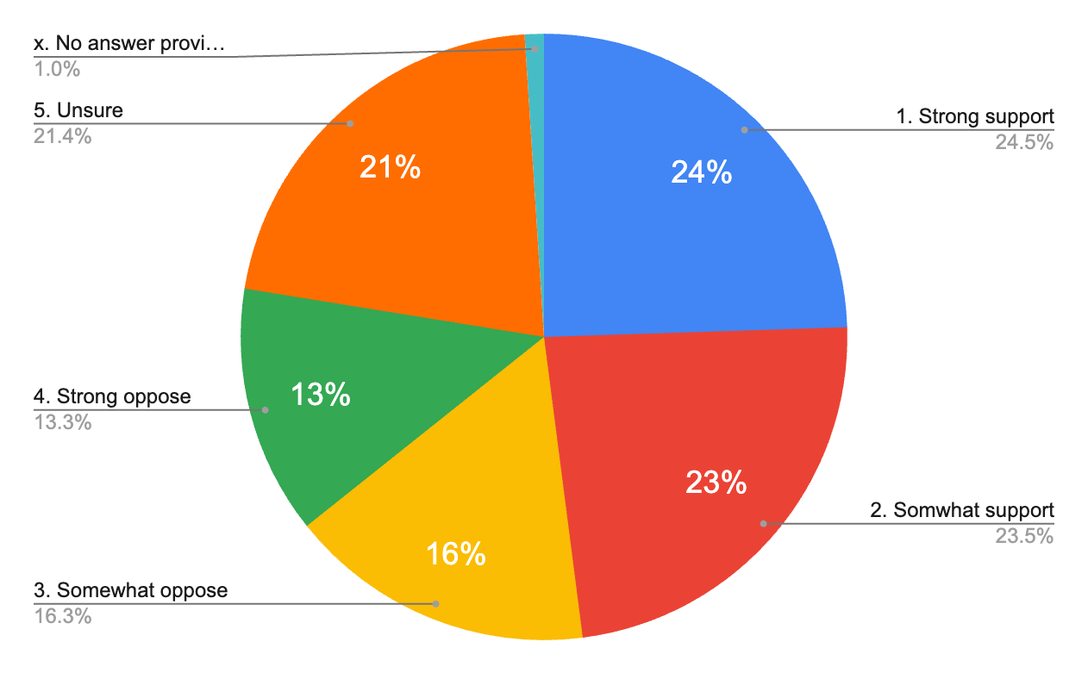
Univariate Main: Fracking

Slide 4
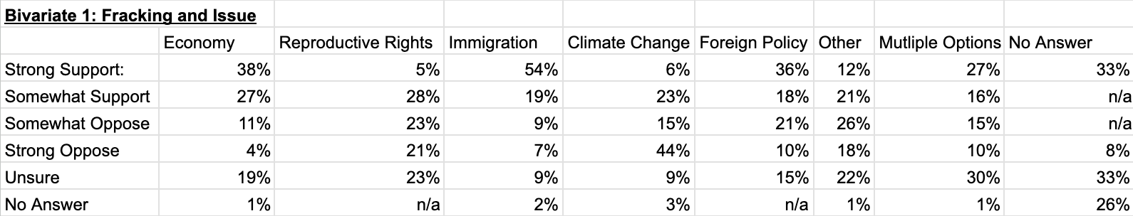
Cooper - Bivariate 1: Fracking and Issues

Slide 5
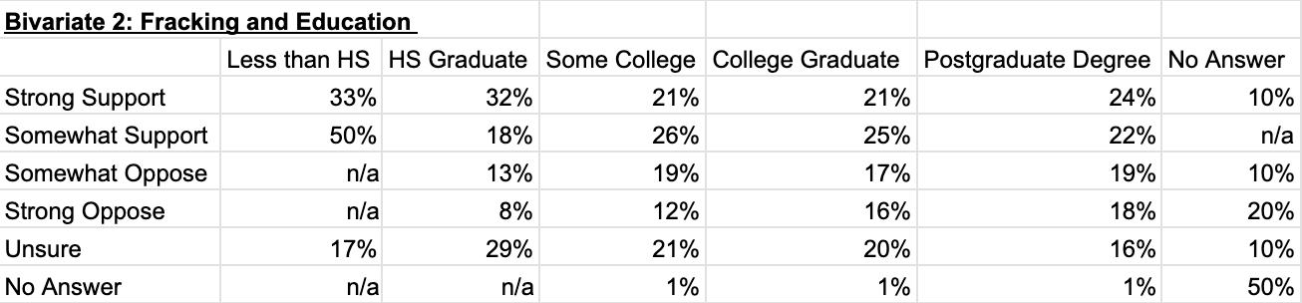
Cooper - Bivariate 2: Fracking and Education

Slide 6
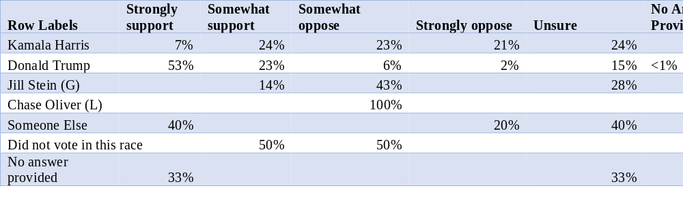
Presidential Vote Choice and Fracking Support
Notes:
Independent Variable: Percentages add up to 100% across the row.
- Harris voters show a more evenly distributed range of opinions on fracking compared to Trump voters.
- Only 7% of Harris voters strongly support fracking, reflecting Democrats’ general liberal stance on renewables and climate change.
- The remaining Harris voters are spread evenly across the other opinion categories.
- This distribution might be influenced by Pennsylvania’s economic ties to fracking-related jobs.
- 53% of Trump voters strongly support fracking, making it the highest single-choice category.
- When combined with “somewhat support,” 76% of Trump voters support fracking.
- 15% of Trump voters are unsure, which is higher than the combined 8% who oppose fracking in any form

Slide 7
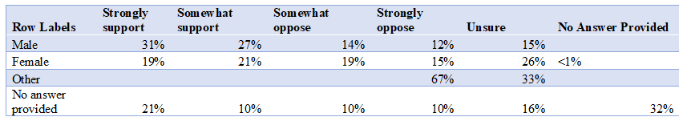
Gender and Fracking Support

Slide 8
Thank you!
Have a good break!

