Slide 1
Public Opinion and Abortion in the 2024 Election
Dalton Surico and Meghan Lord

Slide 2
Methodology
Number of interviews: 660 Election Day Voters in Cumberland County, Pennsylvania/split evenly between A1 & A2
Margin of Error: 3.89% (95% confidence)
Date: Election Day 2024 - November 5, 2024
Method of Interviewing: Self-administered surveys offered by in-person researchers.

Slide 3
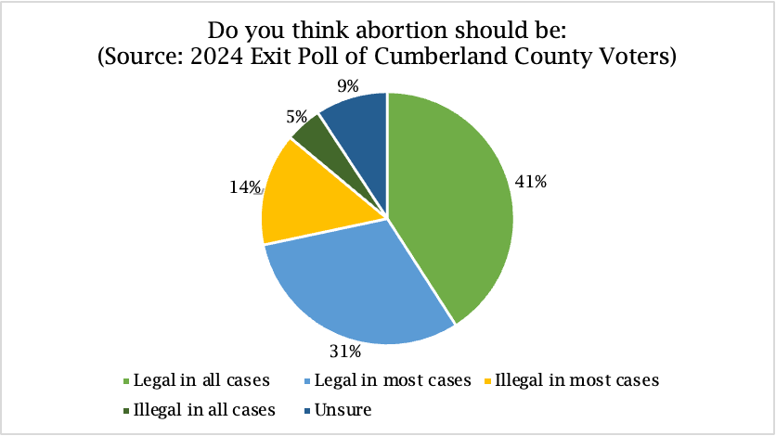
Abortion Legality
Do you think abortion should be… | Out of 660 Respondents
Legal in all cases | 270
Legal in most cases | 203
Illegal in most cases | 95
Illegal in all cases | 31
Unsure | 46
Multiple options chosen | 2
No answer provided | 13

Slide 4
Bivariate Statistics

Slide 5
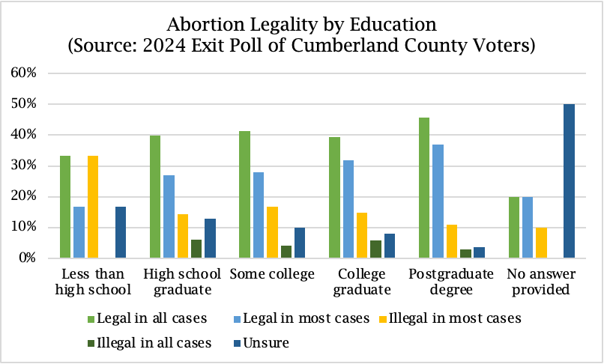
and Education
A
b
o
r
t
i
o
n

Slide 6
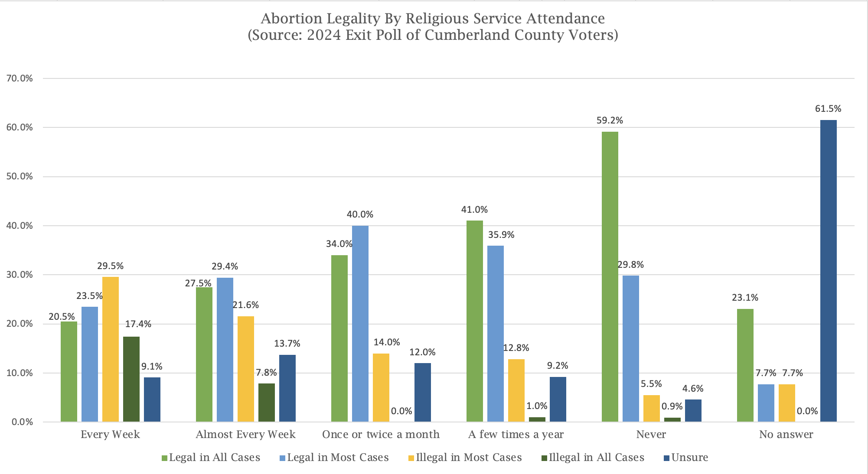
and
A
b
o
r
t
i
o
Religious Service Attendance
n

Slide 7
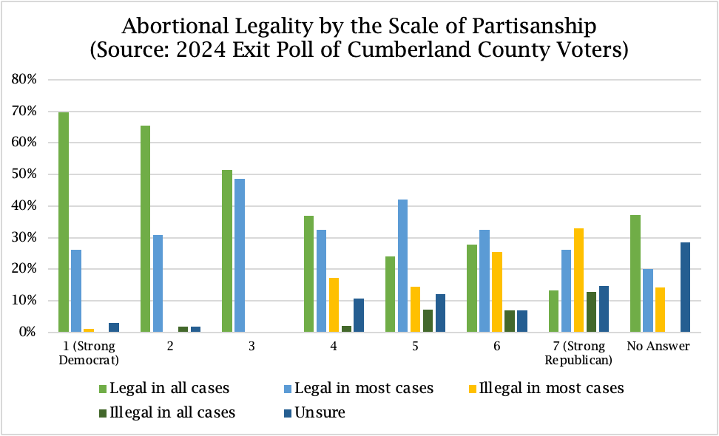
A
b
o
r
t
i
o
n
and Scale of Partisanship

Slide 8
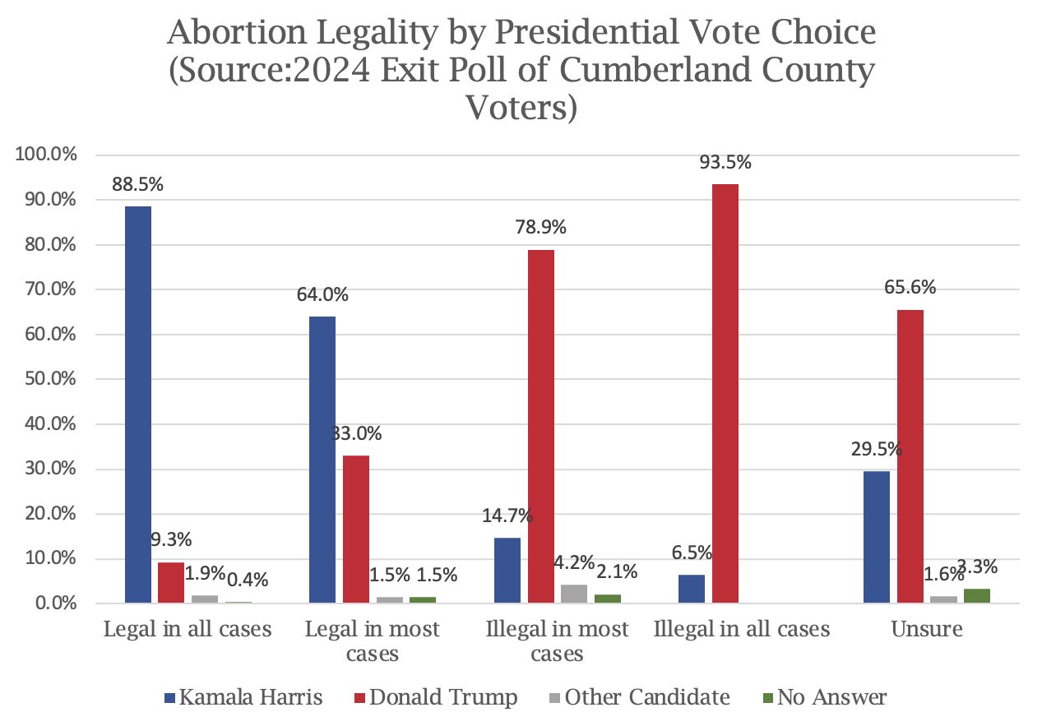
A
b
o
r
t
i
o
n
Presidential Vote Choice and

Slide 9
Thank You!

