Slide 1
2024 Exit Polling Results
By: Caitlyn Bratcher, Lauren Knipe, and Nadia Rosenberg

Slide 2
Methodology
Number of Responses:
660 Election Day Voters in Cumberland County, PA
Margin of Error
± 3.89%
Date Range Survey was in the Field
Election Day 2024 - November 5, 2024
Method of Interviewing
Standing outside polling precinct, asking Cumberland County voters to fill out our survey when we had a clipboard open

Slide 3
01
Univariate Statistics

Slide 4
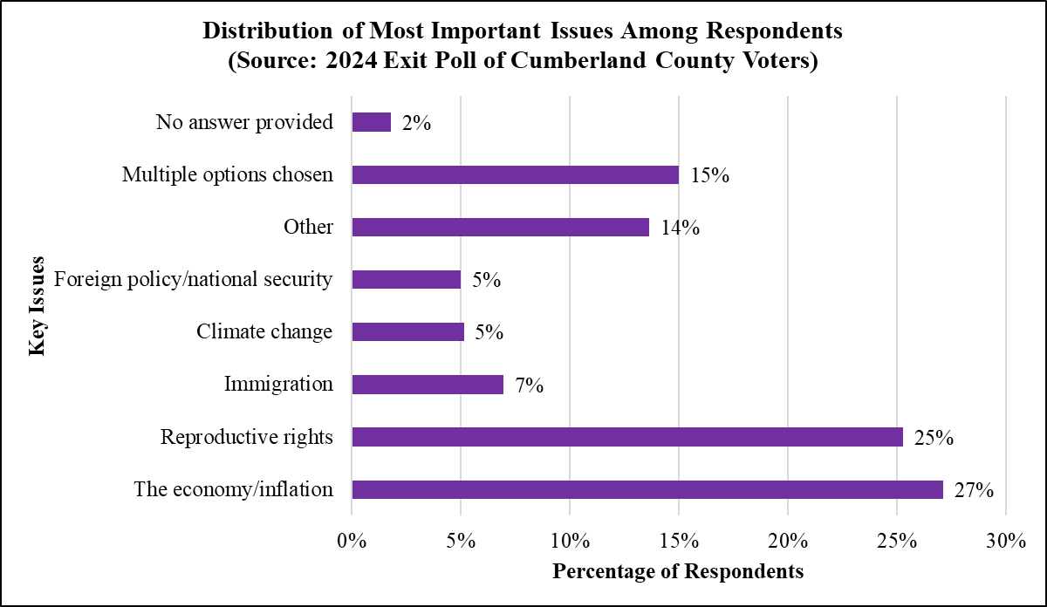
Univariate Graph - Most Important Issue

Slide 5
02
Bivariate Statistics

Slide 6
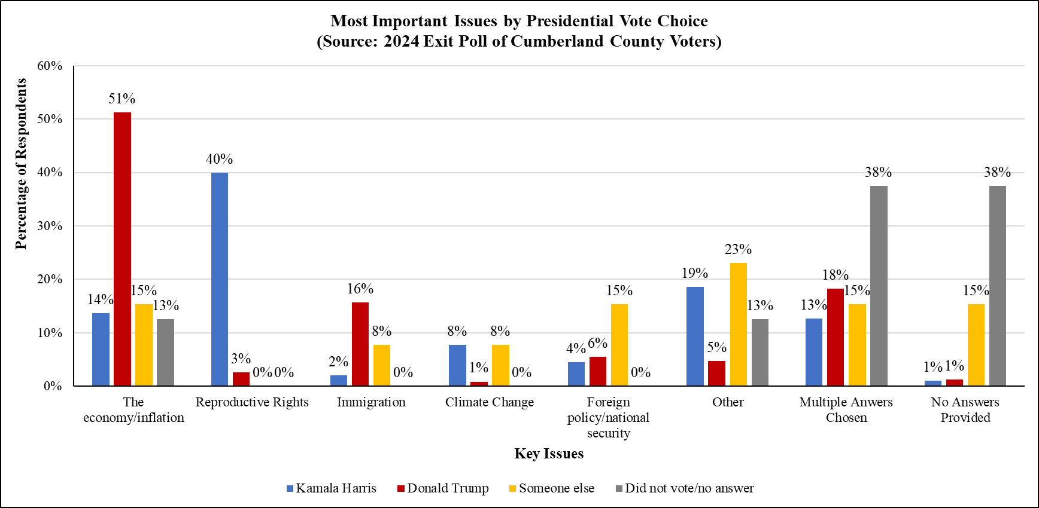
POTUS Choice x Most Important Issue

Slide 7
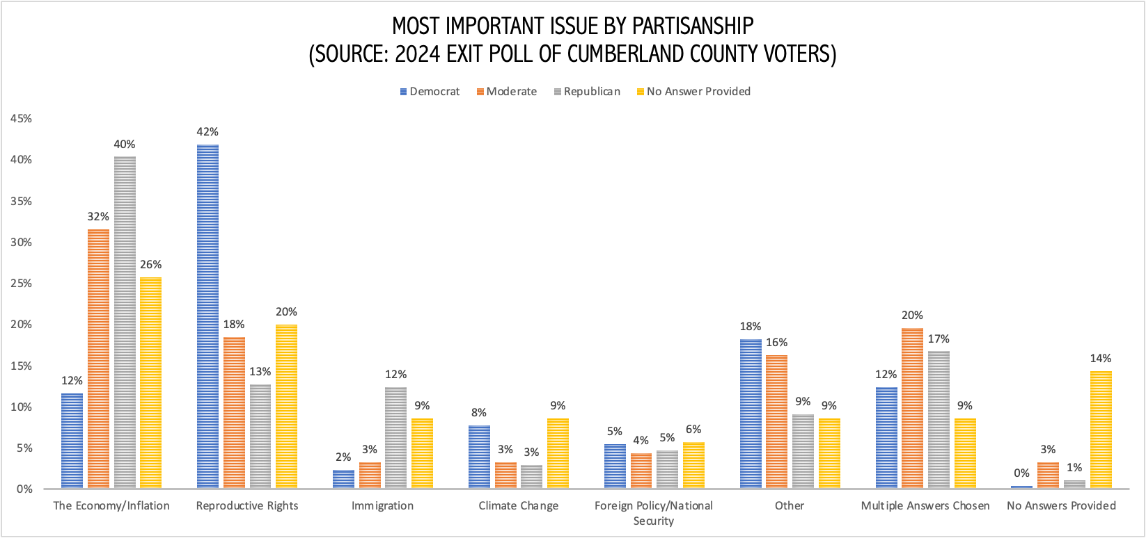
Party ID x Most Important Issue

Slide 8
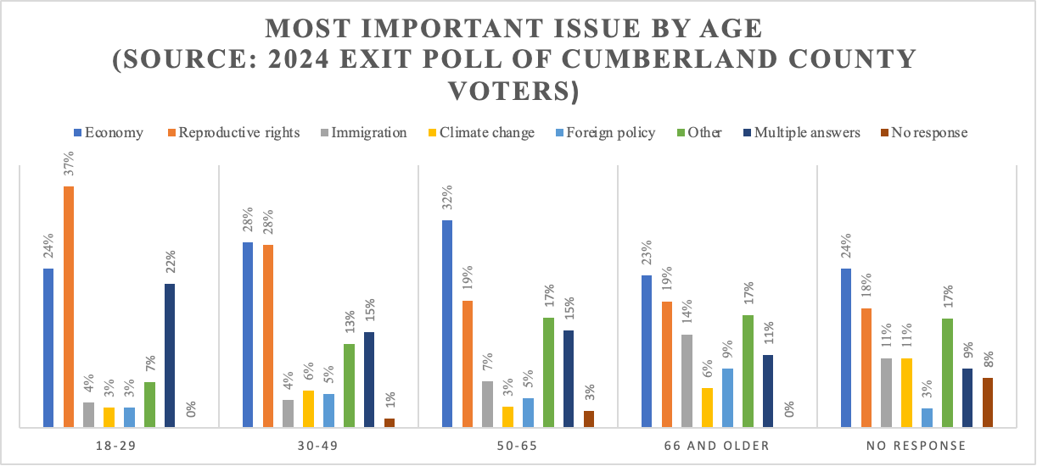
Age x Most Important Issue

Slide 9
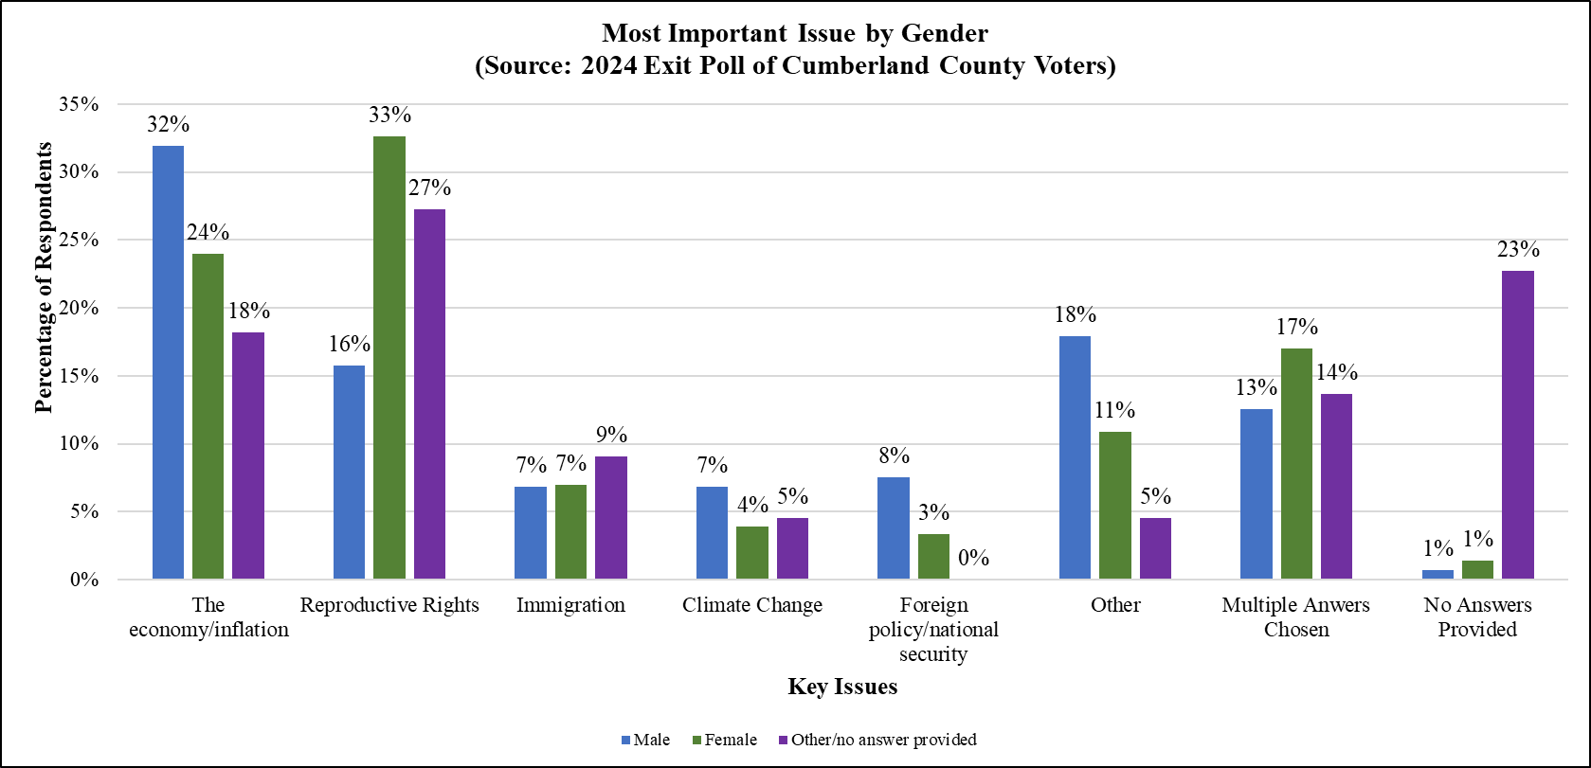
Gender x Most Important Issue

Slide 10
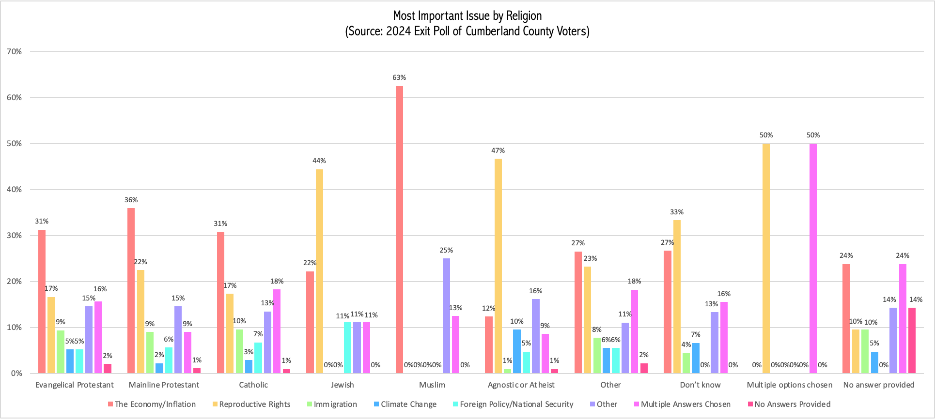
Religion x Most Important Issue

Slide 11
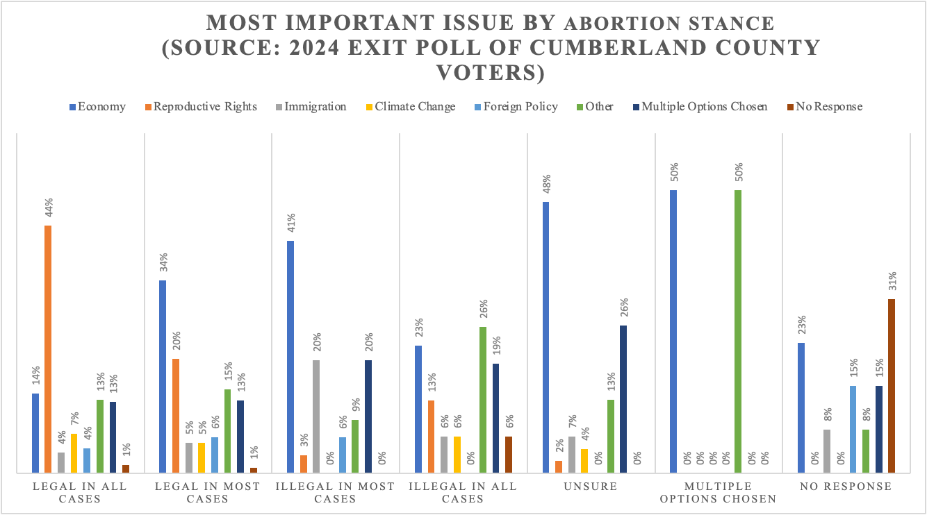
Abortion Stance x Most Important Issue

