Slide 1
Exit Poll Presentation
Riley and Jack

Slide 2
Methodology
660 election day interviews in Cumberland County
Margin of Error: +/-3.89%
- 95% Confidence Interval
Date: Election Day 2024 – November 5th, 2024
Method of Interviewing: Self-administered questionnaire – exit poll

Slide 3
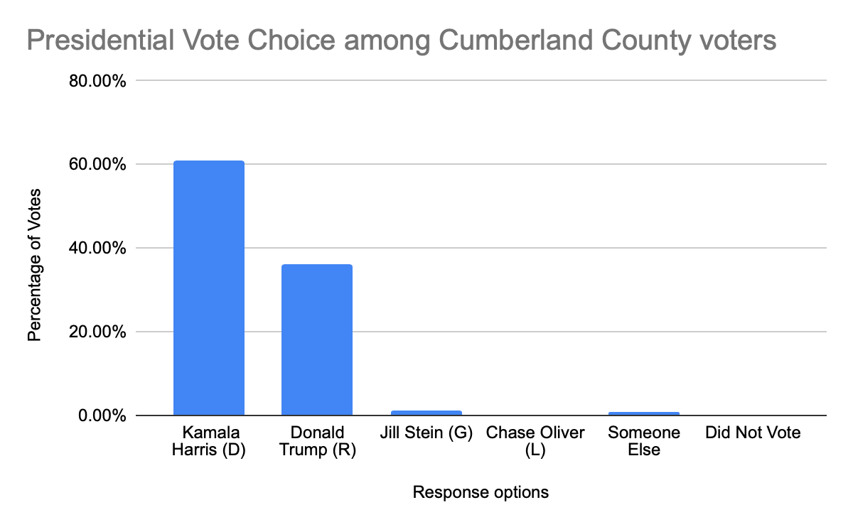
Univariate Statistics

Slide 4
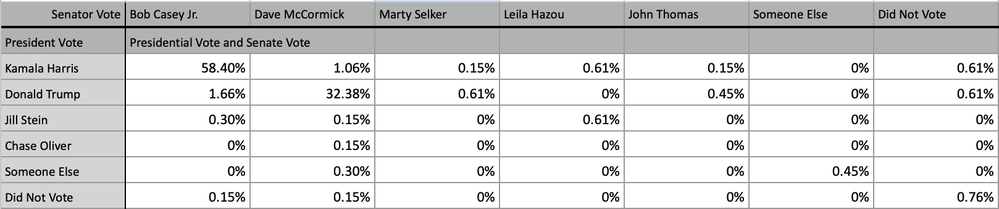
Bivariate – Riley #1

Slide 5
Bivariate – Riley #2

Slide 6
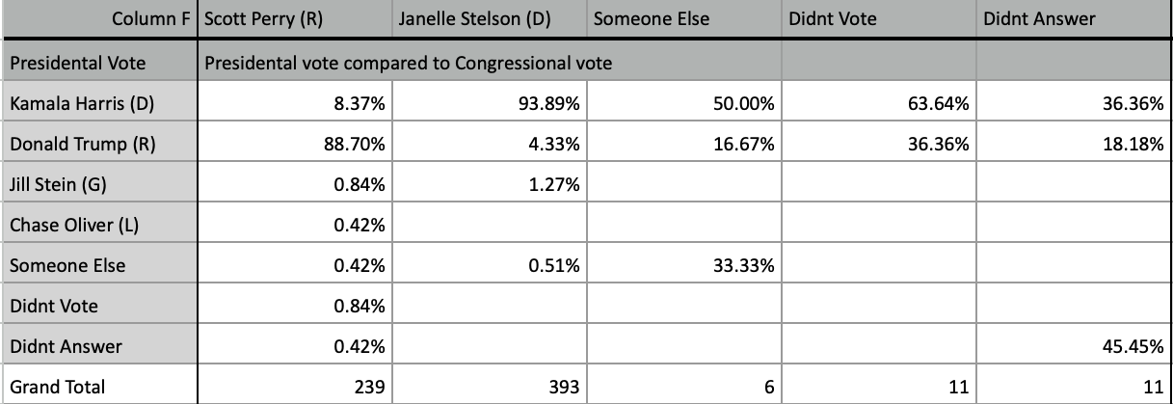
Bivariate-Jack #1

Slide 7
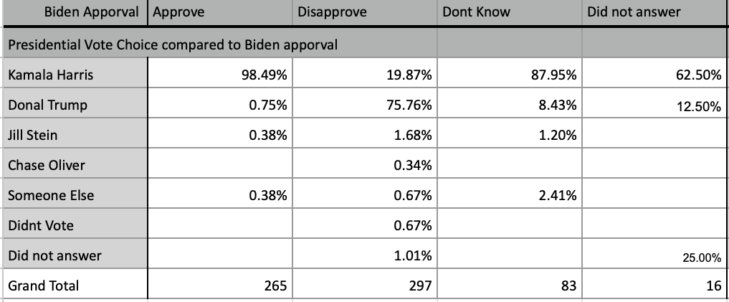
Bivariate-Jack #2

