Slide 1
Religious Affiliation
A Focus on Christianity
Yoshino Hayakawa, Alex Lee, Emma Spinelli

Slide 2
Methodology
Number of Interviews: 660 Election Day Voters in Cumberland County,
Pennsylvania
Margin of Error: +/- 3.9% with a 95% confidence interval
Date: November 5, 2024
Method of Interviewing: Interviews took place in person at polling places. Once voters exited the polling place, they were asked if they wanted to participate in a one-sided, anonymous questionnaire.

Slide 3
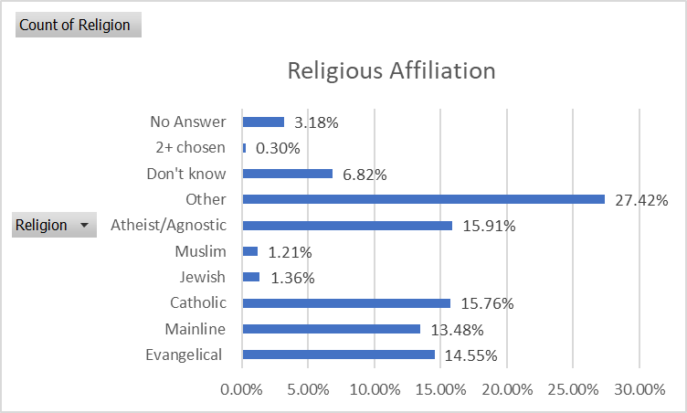
Univariate— Religious Affiliation

Slide 4
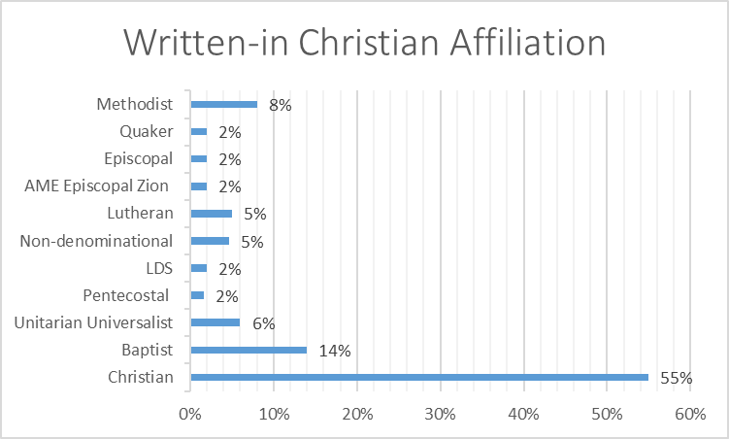
Univariate— Written-in Christian Affiliation
*Data does not add up to 100% because of whole number rounding

Slide 5
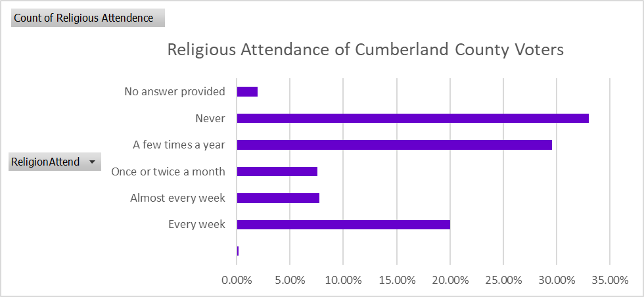
Univariate– Religious Attendance

Slide 6
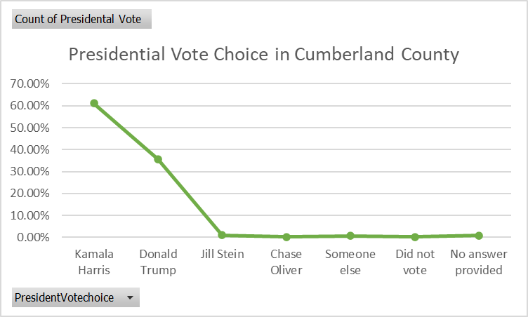
Univariate–Presidential Vote Choice

Slide 7
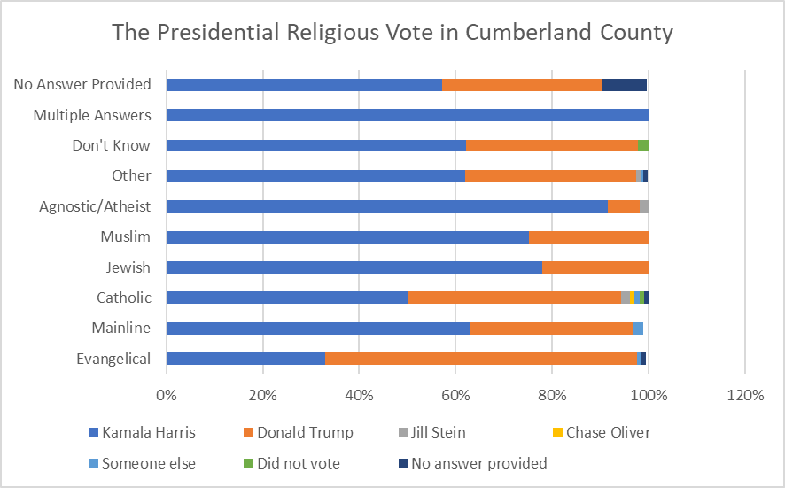
Bivariate— Religious Presidential Vote Choice
*Not all sections add up to 100% because of rounding

Slide 8
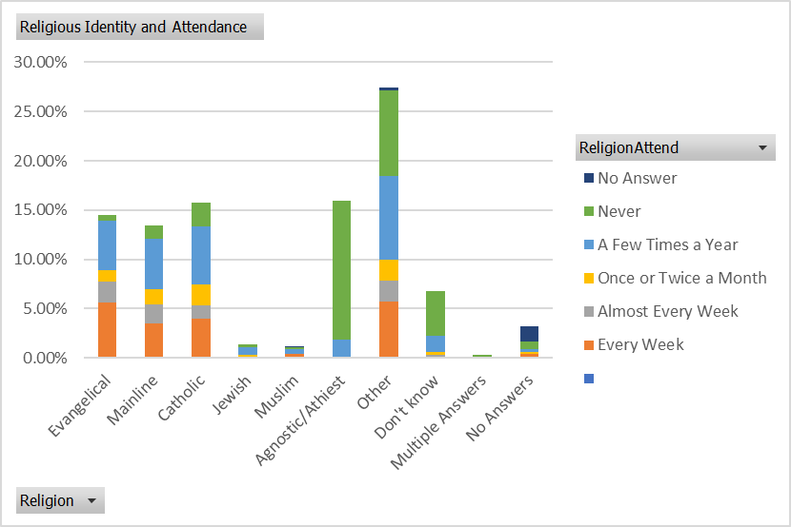
Bivariate – Religious Identity and Attendance

Slide 9
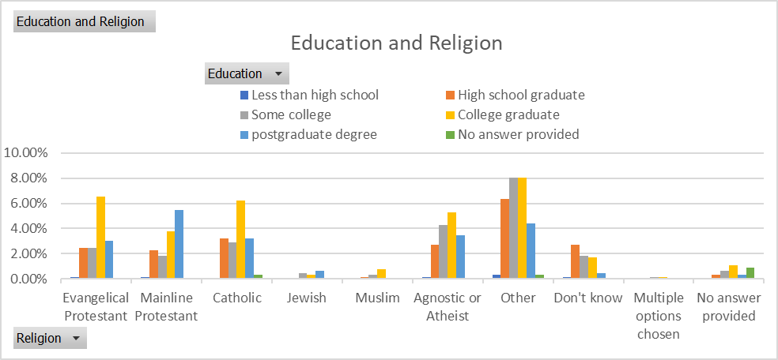
Bivariate— Education Level
l

Slide 10
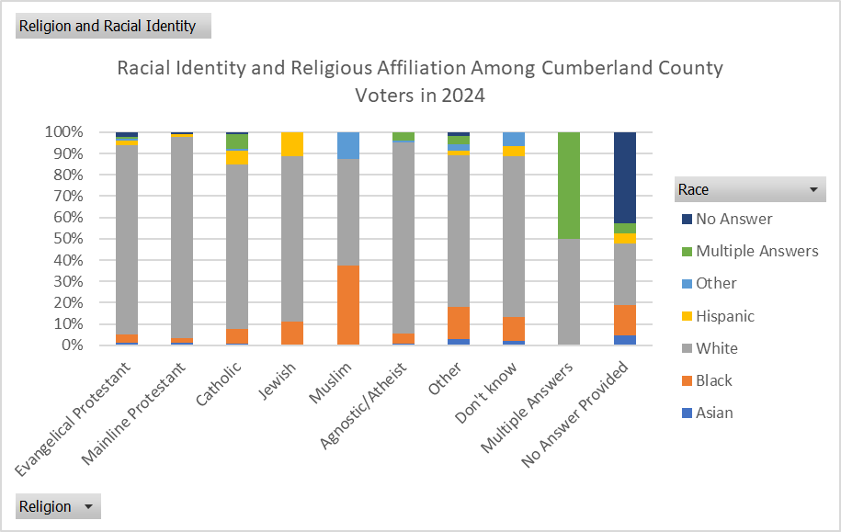
Bivariate— Racial Identity

Slide 11
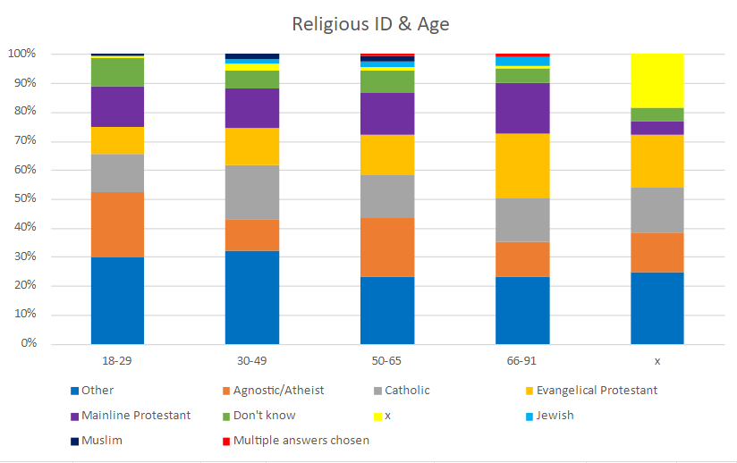
Bivariate— Religious ID and Age

Slide 12
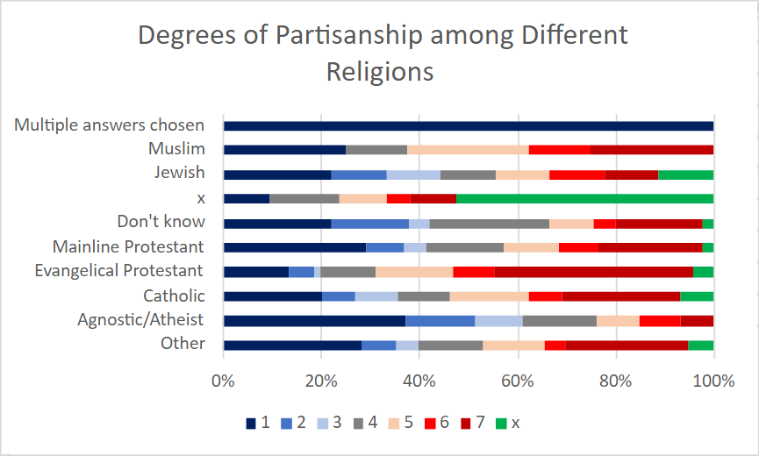
Bivariate— Religious ID & Party ID
Notes:
About 64% of evangelical protestants right leaning to various degrees, for mainline protestants about 42% D leaning and 40% R leaning, for Catholics 36% D leaning and 47% R leaning

Slide 13
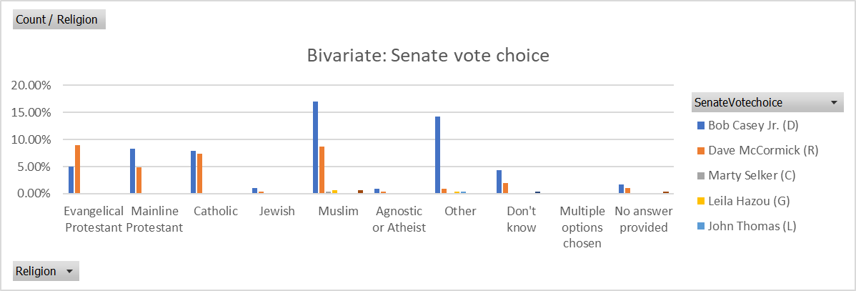
Bivariate— Senate vote choice

Slide 14
Conclusions
Evangelical Christians vote for Trump more often than Harris, and Mainline Christians vote for Harris more often than Trump.
Evangelical Christians were most likely to identify as a strong Republican.
Mainline Christians have more postgraduate degrees than Evangelical Christians

