Slide 1
POSC 244
Polling Presentation
Mason Weller, Andrew Garcia, Caleb Riener

Slide 2

Our Methodology
Cumberland County, Pennsylvania
660 in person election day voters were surveyed
November 5th 2024, Election Day
Our methodology on the day included approaching people who had just voted and asking them to complete a one-page, anonymous paper survey.
The margin of error of the respondent data collected is +/- 3.89%.

Slide 3
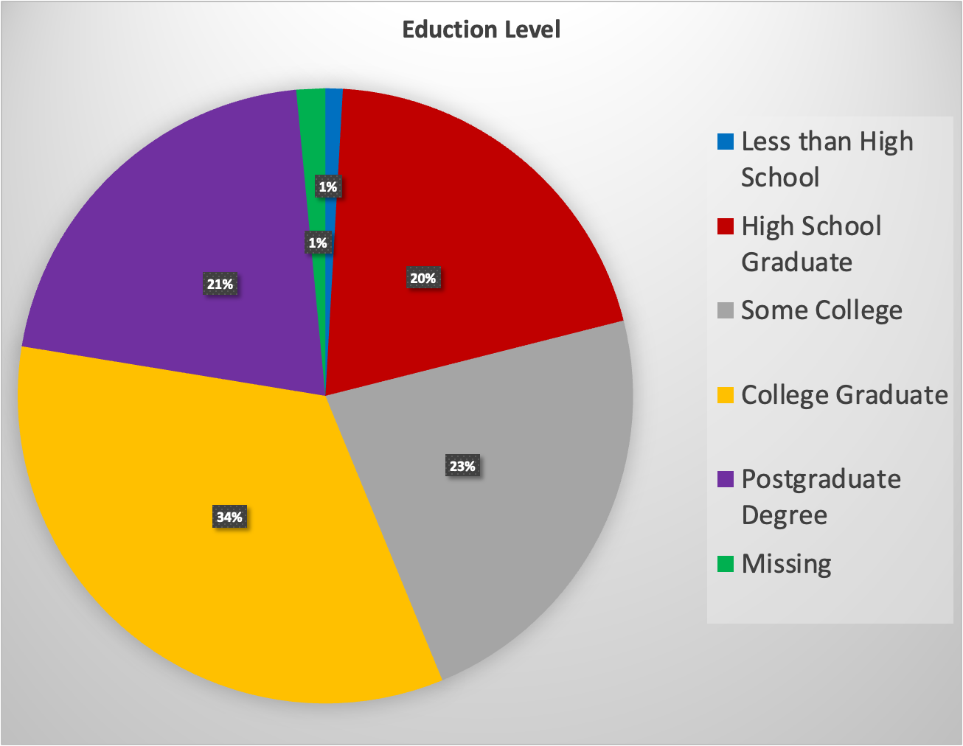
Chart and Graphic Showing Education Level
Row Labels | Count of Education
Less than High School | 6
High School Graduate | 133
Some College | 150
College Graduate | 223
Postgraduate Degree | 138
Missing | 10
Grand Total | 660

Slide 4
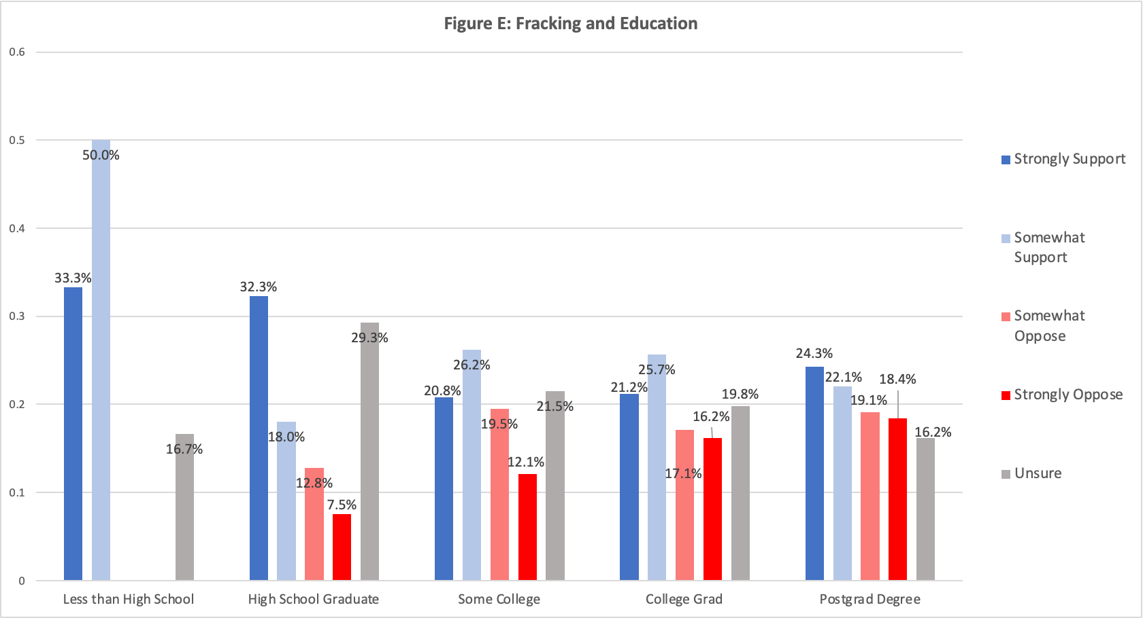

Slide 5
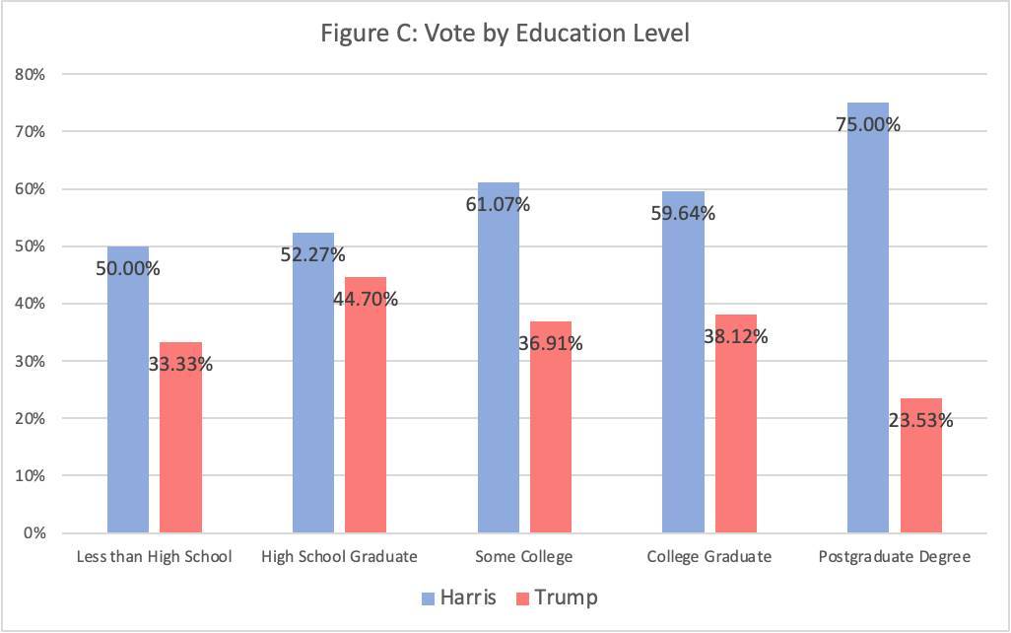

Slide 6
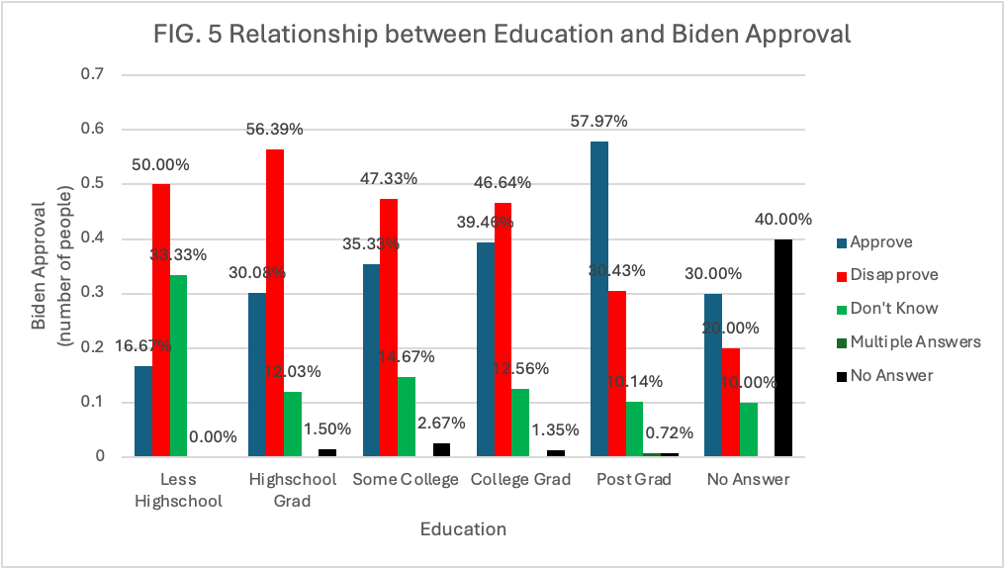

Slide 7
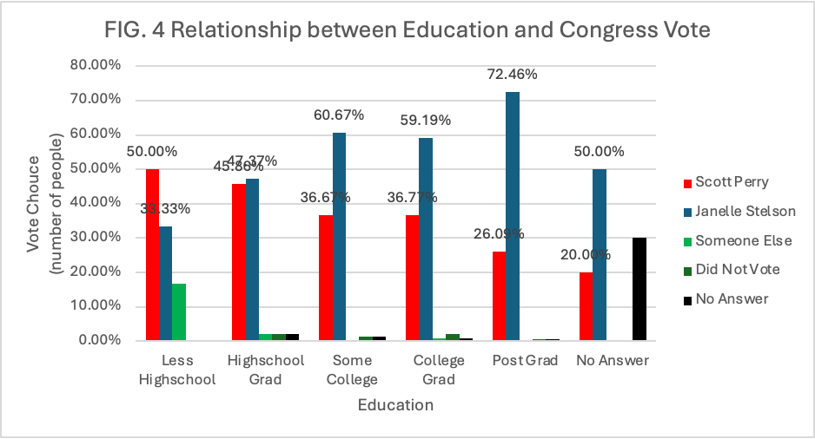

Slide 8
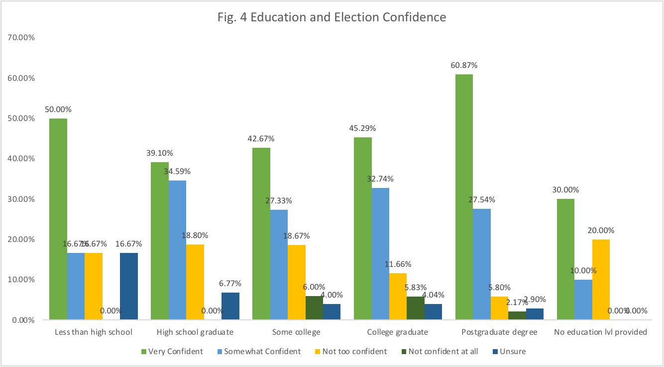

Slide 9
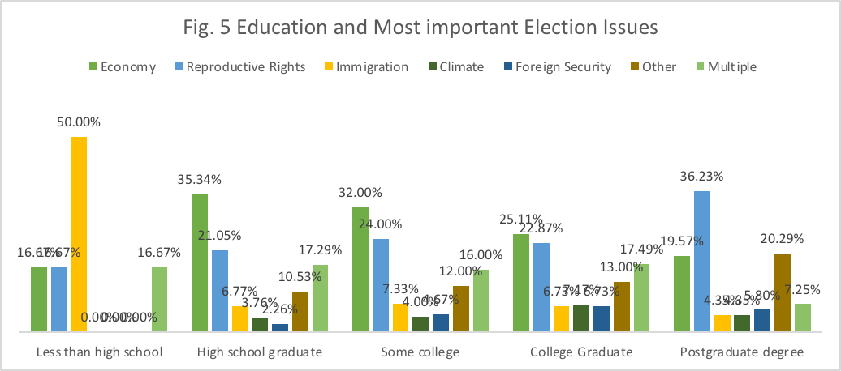
Charts or graphics that show bivariate relation between education and other 6 Mason Education (independent) and Most Important Issue (dependent).

