Slide 1
Exit Poll Survey Analysis
Sophie Bailey & Patrick Mocarsky

Slide 2
Methodology
Number of Interviews: 660 Election Day Voters in Cumberland County, Pennsylvania
Interviews conducted on Election Day 2024, November 5th
Method of Interviewing: In-person self-administered survey
Margin of error: 3.89%+-

Slide 3
Race/Ethnicity: Univariate Analysis

Slide 4
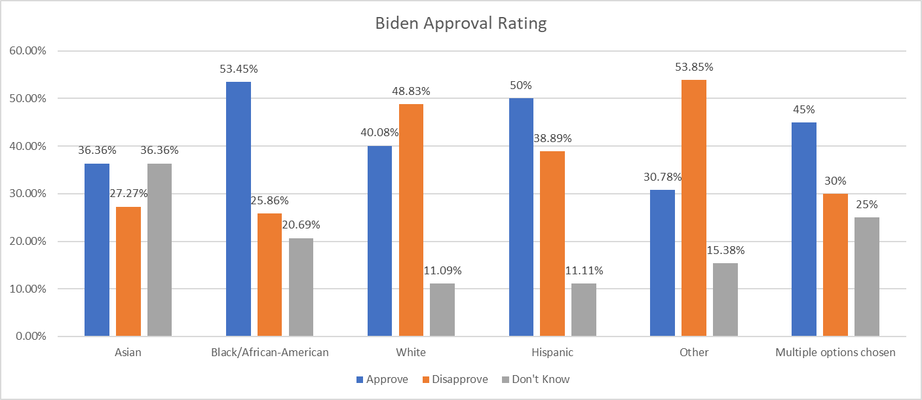
Biden Approval Rating and Race: Bivariate Analysis

Slide 5
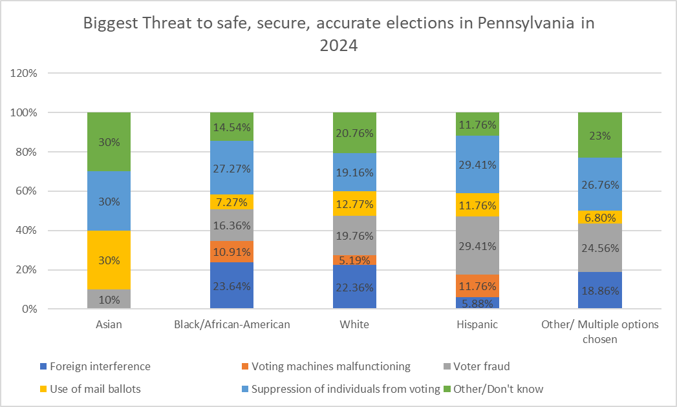
Biggest Threat to Election Integrity and Race: Bivariate Analysis

Slide 6
Presidential Vote Choice and Race: Bivariate Analysis

Slide 7
Most Important Issue in the Election and Race: Bivariate Analysis

