Slide 1
Partisanship and…
Dylan Stroppa and Maddie Fecko

Slide 2
Methodology
Number of Interviews- 660 Election Day Voters in Cumberland County, Pennsylvania
Margin of Error- +/- 3.89% at 95% confidence level
Date- Election Day, November 5, 2024
Method of Interviewing:
  In person paper surveys administered outside of polling places after respondents voted
  Administered by students of Dickinson College
  Surveys included information about vote choice, significant political issues, and demographics

Slide 3
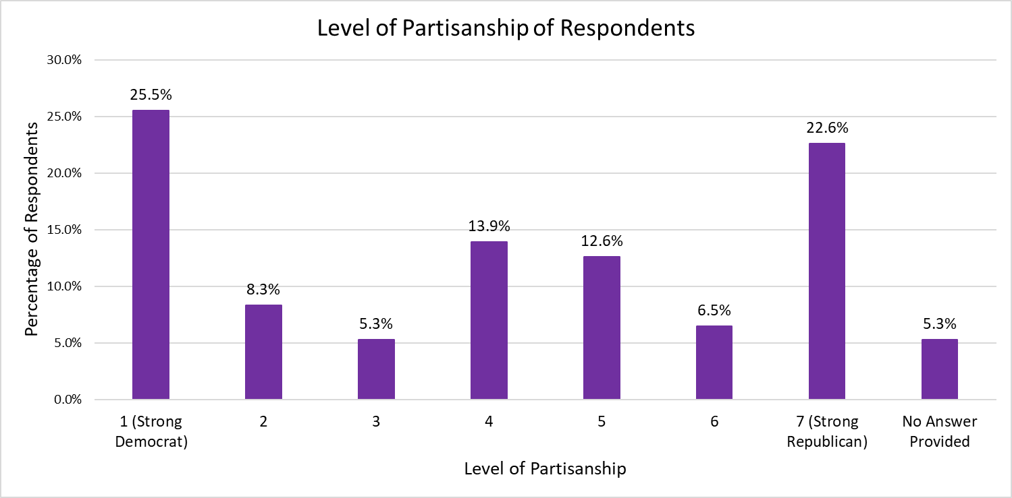

Slide 4
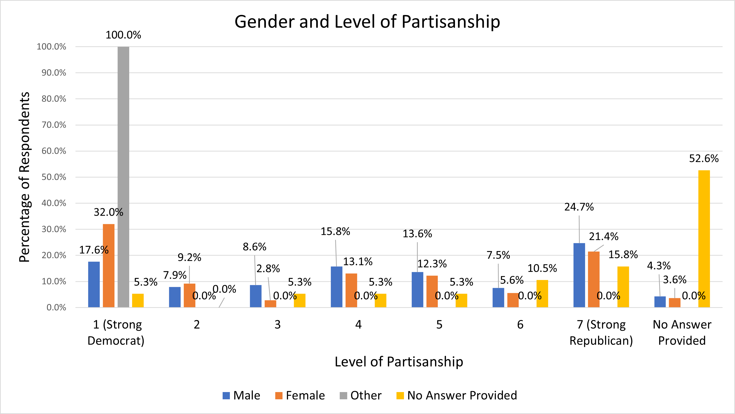

Slide 5
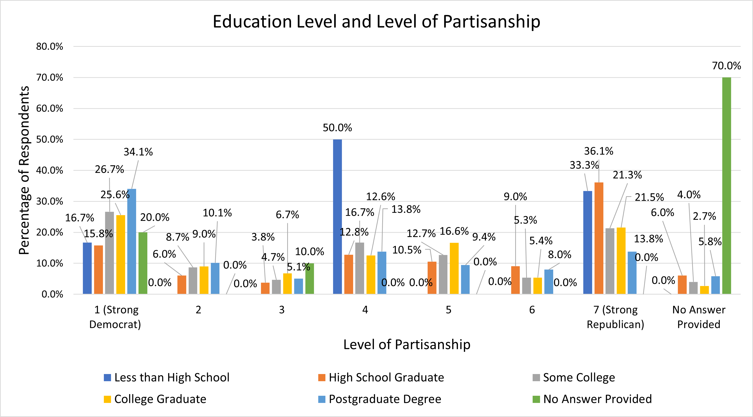

Slide 6
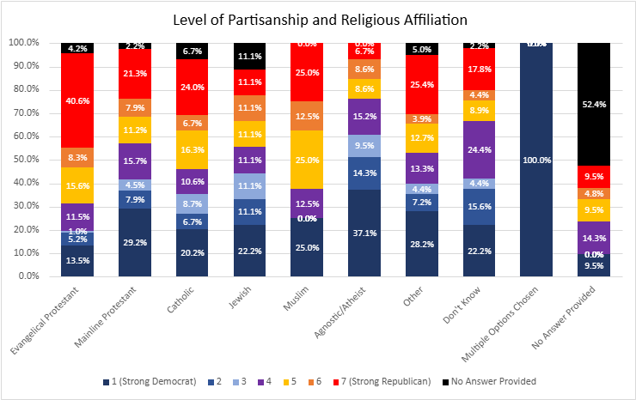

Slide 7
