Slide 1





Exit Polling
Final Project
Robin Varol & Faith Parker

Slide 2


METHODOLOGY
MAIN QUESTION
BIVARIATE RELATIONSHIPS
Number of interviews: 660 Election Day Voters in Cumberland County, Pennsylvania
Margin of Error: ±3.89%
Date: Election Day 2024 – November 5, 2024
Method of Interviewing: A combination of in-person interviewing and self-administered questionnaire methods. Survey respondents were asked by the interviewer to fill out a paper questionnaire on their own after exiting polling place.

Slide 3

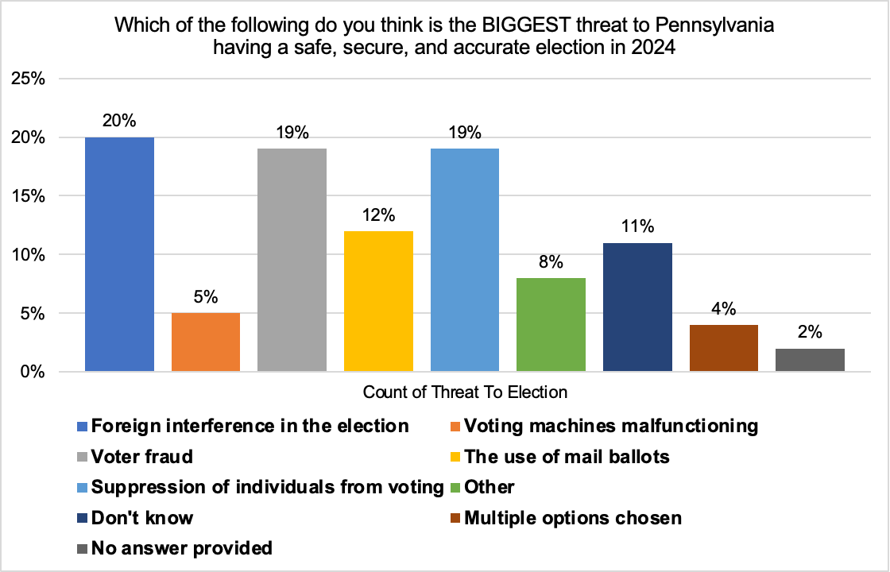
METHODOLOGY
MAIN QUESTION
BIVARIATE RELATIONSHIPS

Slide 4

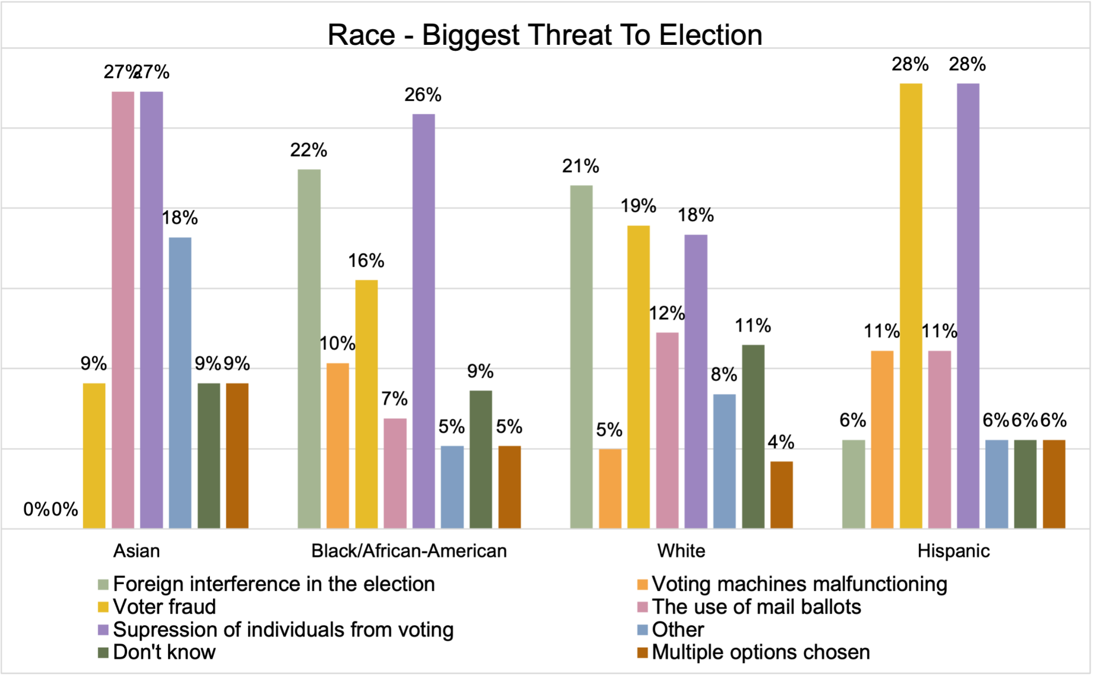
METHODOLOGY
MAIN QUESTION
BIVARIATE RELATIONSHIPS

Slide 5
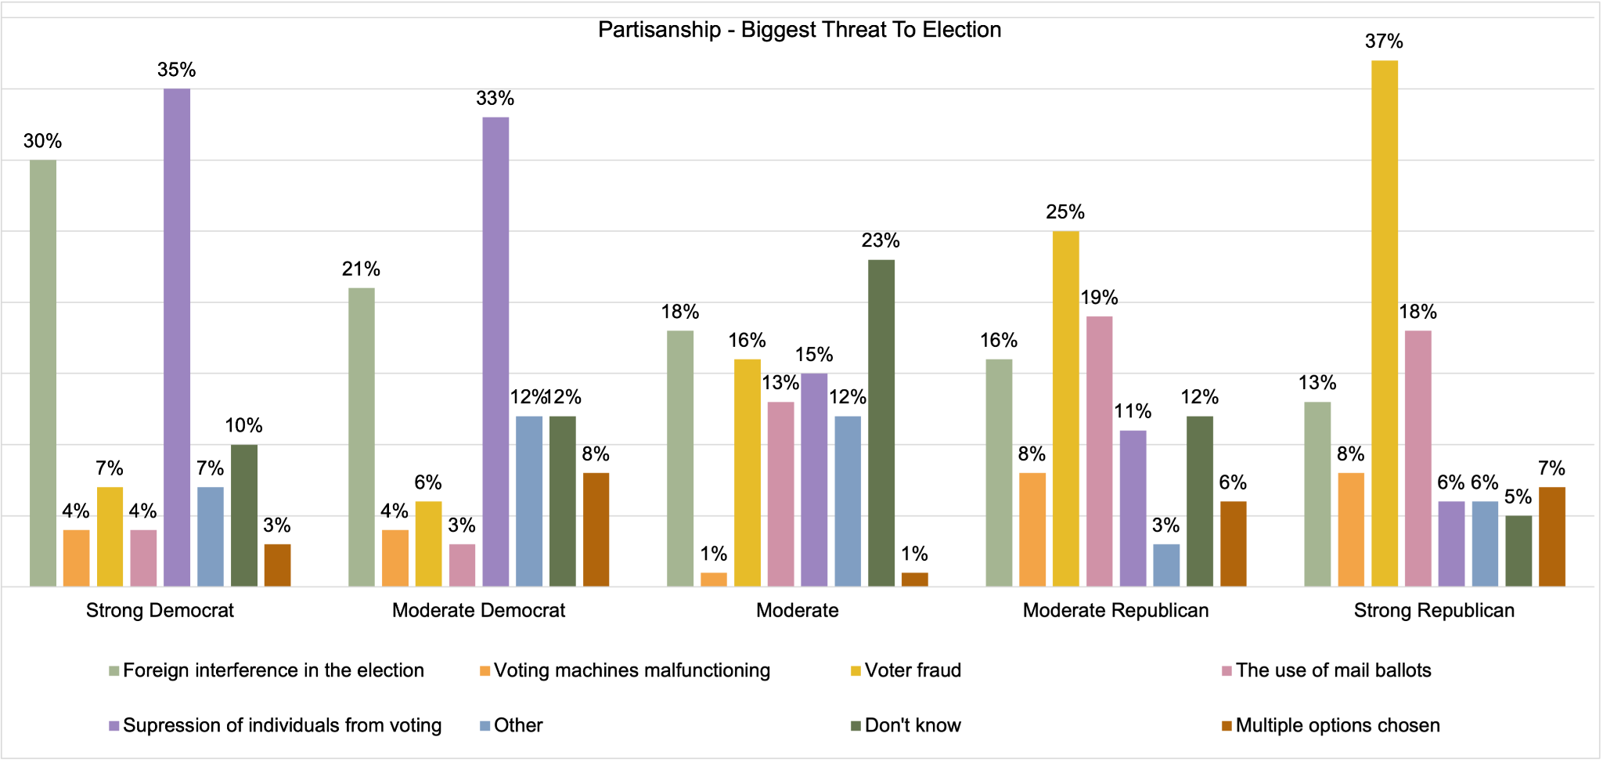
METHODOLOGY
MAIN QUESTION
BIVARIATE RELATIONSHIPS

Slide 6
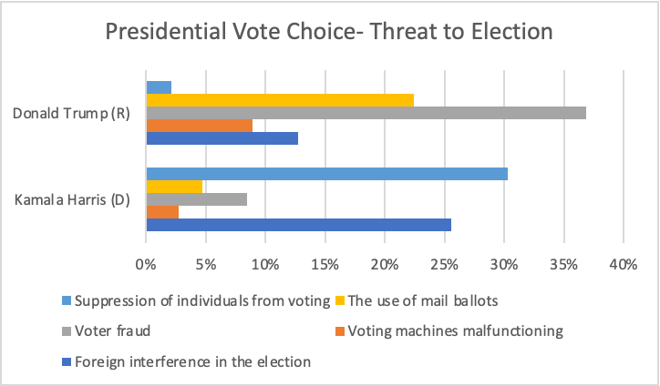
METHODOLOGY
MAIN QUESTION
BIVARIATE RELATIONSHIPS
Excluded non-Trump/non-Harris voters
Notes:
In both bivariate graphs, I excluded answers like other, do not know, provided multiple answers, or failed to answer. This was it is easier to analyze visually, and see the partisan divide on views surrounding the biggest threat to the election.

Slide 7
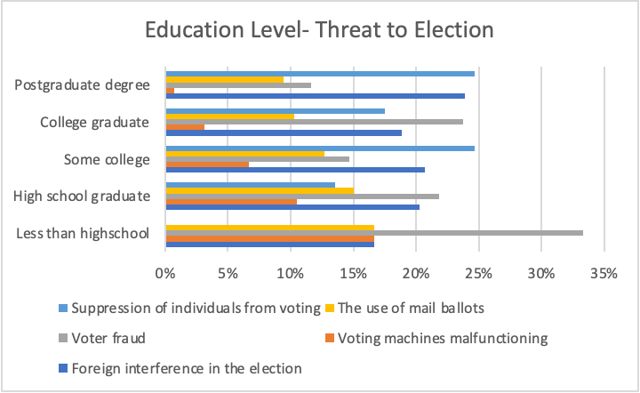
METHODOLOGY
MAIN QUESTION
BIVARIATE RELATIONSHIPS

