Slide 1






Legitimacy of 2024 Election Results
a survey-driven analysis
Mina Lee and Audrey Herman

Slide 2

Methodology
Number of Interviews: 660 Election Day Voters in Cumberland County, Pennsylvania
Margin of Error: ±3.89%
Date: Election Day 2024- November 5, 2024
Method of Interviewing: In person, self-administered, convenience sampling method

Slide 3
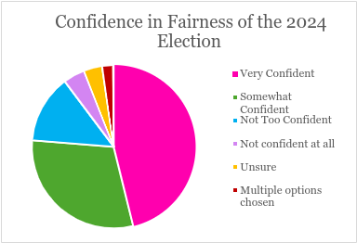
Univariate Statistics
Level of Confidence | Percentage of Respondents
Very Confident | 46.50%
Somewhat Confident | 30.30%
Not Too Confident | 13.60%
Not confident at all | 4.30%
Unsure | 3.70%
Multiple options chosen | 2.20%
No answer provided | 0.10%
Grand Total | 100.70%

Slide 4
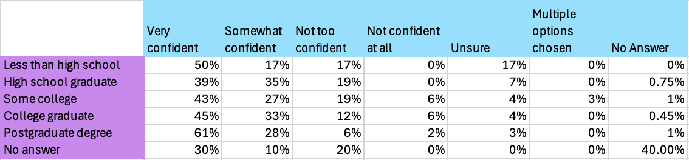
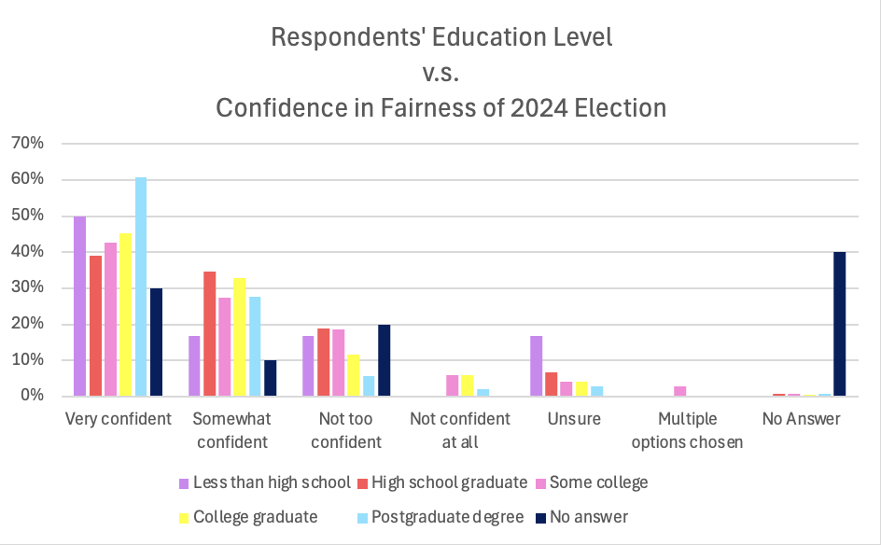
Mina: Education

Slide 5
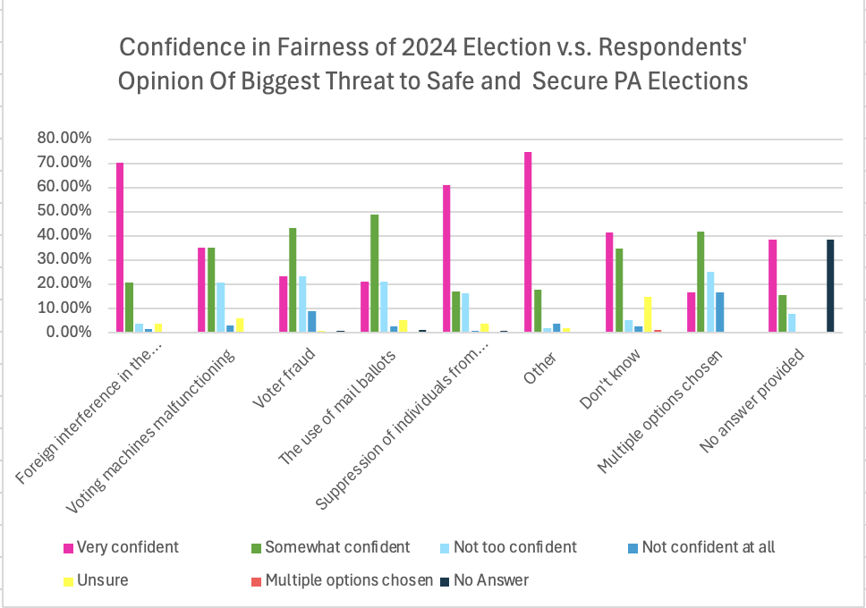
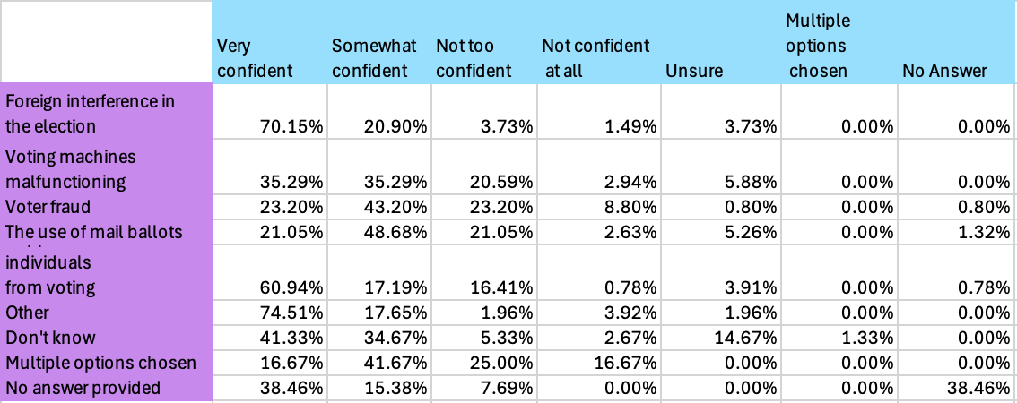
Mina: threat to democracy

Slide 6
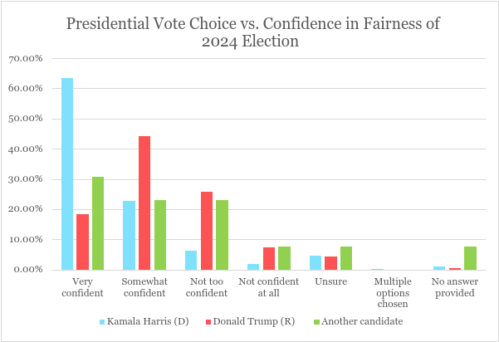
Audrey: Presidential Vote Choice
 | Very confident | Somewhat confident | Not too confident | Not confident at all | Unsure | Multiple options chosen | No answer provided
Kamala Harris (D) | 63.50% | 22.80% | 6.20% | 1.70% | 4.50% | 0.20% | 0.90%
Donald Trump (R) | 18.20% | 44.10% | 25.80% | 7.20% | 4.20% |  | 0.40%
Another candidate | 30.80% | 23.10% | 23.10% | 7.70% | 7.70% |  | 7.70%
Did not vote in this race |  | 50% | 50%
No answer provided | 66.60% |  |  |  |  |  | 33.30%

Slide 7
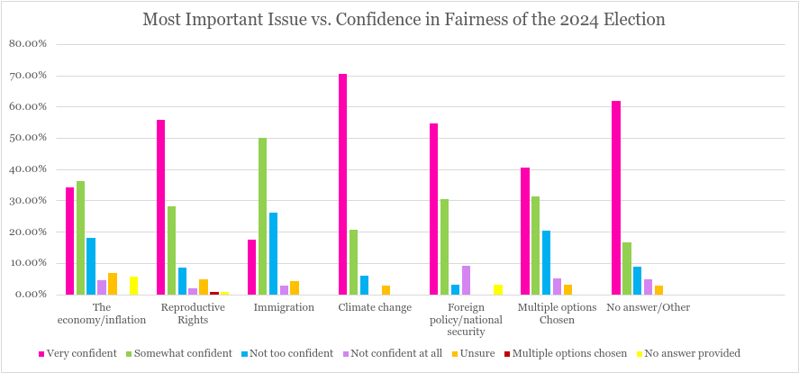
Audrey: Most Important Issue
 | Very confident | Somewhat confident | Not too confident | Not confident at all | Unsure | Multiple options chosen | No answer provided
The economy/inflation | 34.10% | 36.30% | 17.90% | 4.50% | 6.70% |  | 5.60%
Reproductive Rights | 55.70% | 28.10% | 8.40% | 1.80% | 4.80% | 0.60% | 0.60%
Immigration | 17.40% | 50% | 26.10% | 2.80% | 4.30%
Climate change | 70.60% | 20.60% | 5.90% |  | 2.90%
Foreign policy/national security | 54.50% | 30.30% | 3.00% | 9.10% |  |  | 3.00%
Multiple options Chosen | 40.40% | 31.30% | 20.20% | 5.10% | 3.00%
No answer/Other | 61.80% | 16.70% | 8.80% | 4.90% | 2.90%

