Slide 1
The Environment
By,
Justin Smalley
Patrick Cosgrave

Slide 2
Methodology
-69 Respondents
-Margin of Error +/- 11.8%
-Interview Method- Online Survey between April 3-10th
-Emails were sent out to Dickinson College students who are members of Greek Life, Football, Cross Country/Track, and the Tree House Center for Sustainable Living. Respondents were then instructed to answer 20 questions regarding the environment.
-17% of respondents were either environmental studies or science majors/minors

Slide 3
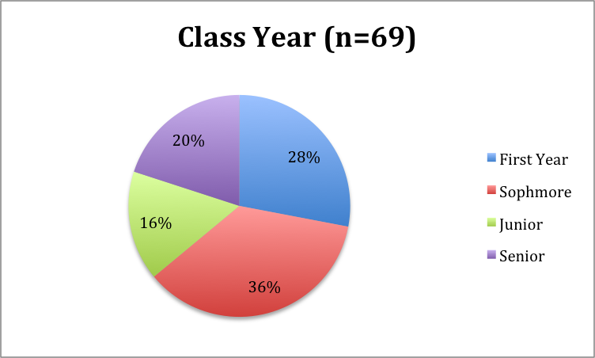

Slide 4
Goal
To better understand how Dickinson College students think about issues related to the environment both locally and nationally.

Slide 5
First
We looked at how Dickinsonians view the environment from their first decision to come study here, to how their living situation impacts their views.

Slide 6
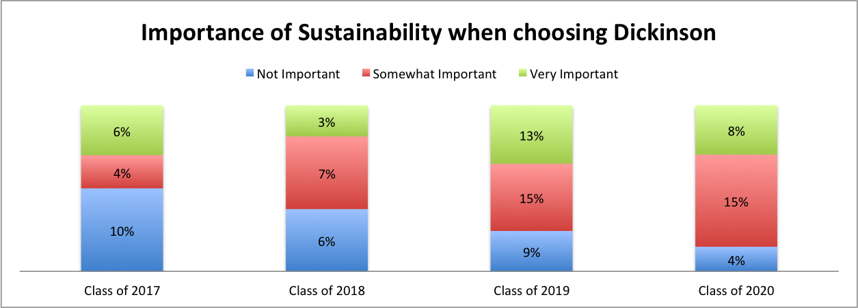

Slide 7
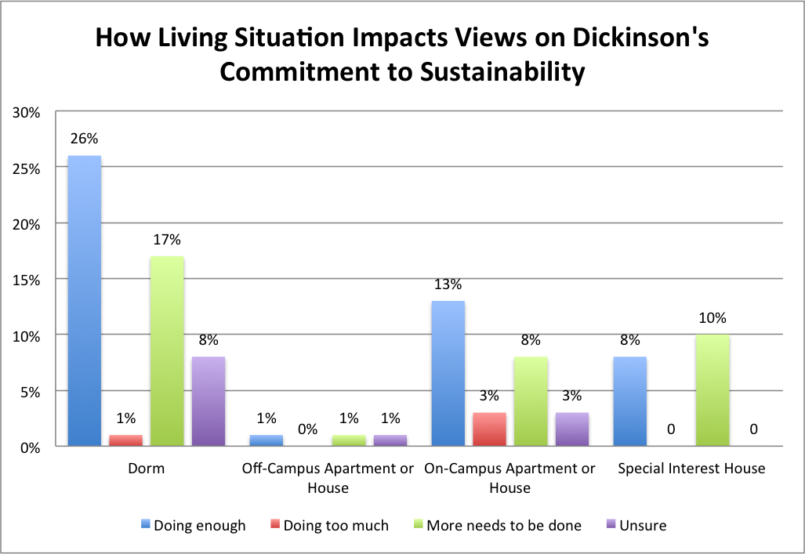

Slide 8
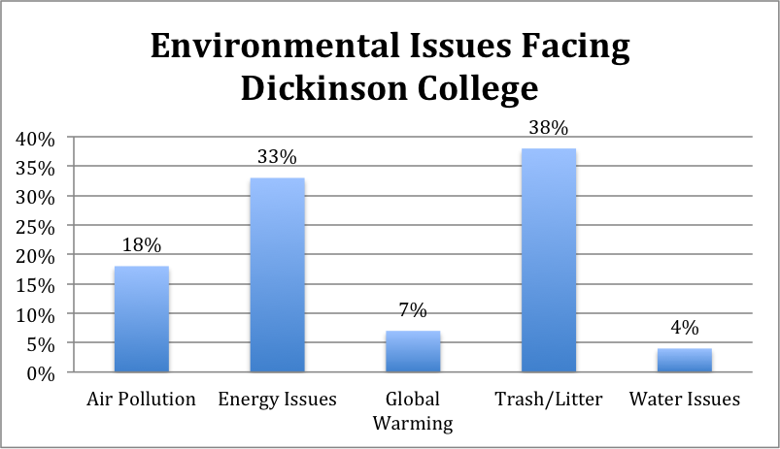

Slide 9
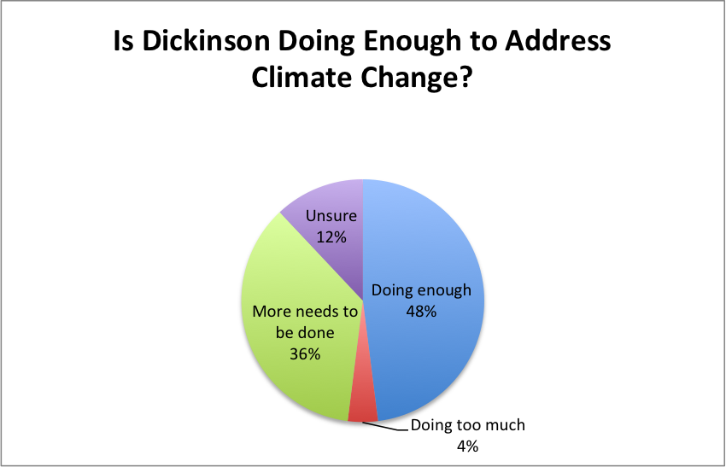

Slide 10
We then looked at this in relation to how Dickinsonians view environmental issues on a national scale.

Slide 11
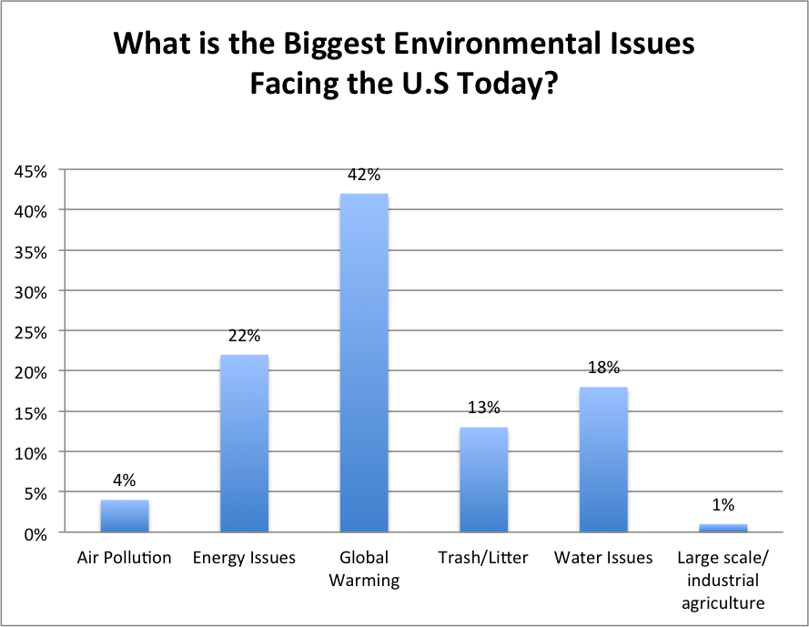

Slide 12
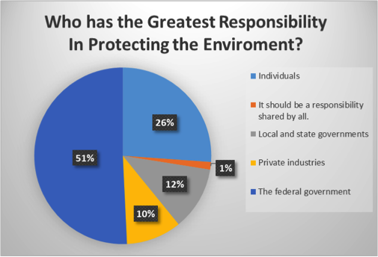

Slide 13
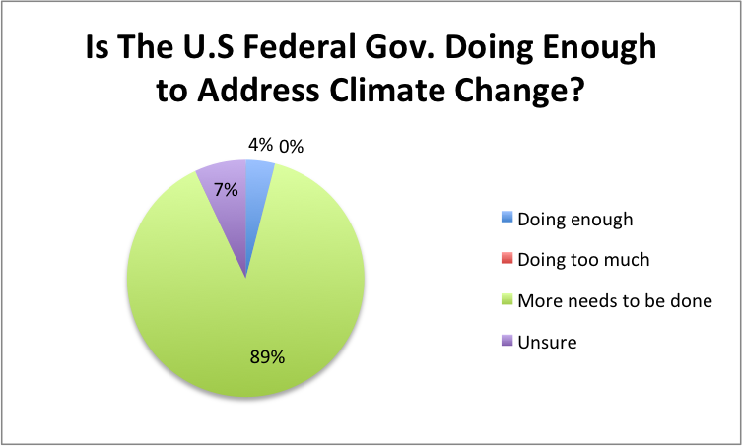

Slide 14
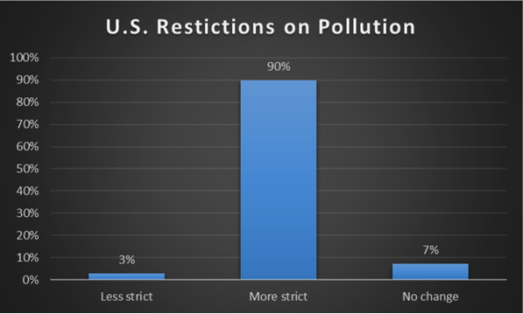

Slide 15
Results
-Dickinson students care about the environment
-we found that environmentalism and environmental awareness goes beyond just students who are environmental majors/minors
-Students feel that while more needs to be done at both the local and federal level, the federal level needs to do much more.
-An interesting follow up question would have been who has a greater responsibility to protect the environment? Public or private institutions?

