Slide 1
Survey on the Environment
POSC 244: Public Opinion and Survey Research
Avery Pietras and Emma Weaver
May 12, 2017

Slide 2
Methodology
Respondents: 69
Margin of Error: +/-11.8
Survey in the Field from April 3rd to April 10th,2017
Specific Groups Targeted: Kappa Kappa Gamma, the Football Team, the Track and Field Team, the Cross Country Team, and the Treehouse
Number of Questions: 20
Administered through an online Google forum

Slide 3
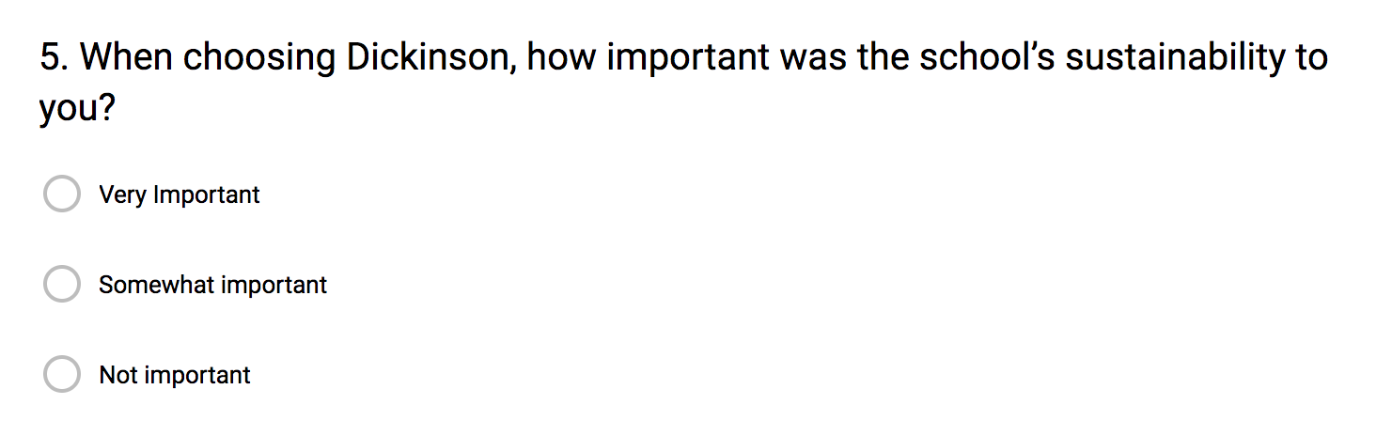
https://docs.google.com/forms/d/1s1S3mok8Imrb2C4Xm4wexV27yOFn3wT3EH-DUcPkZqU/edit

Slide 10
Closing Remarks
What we found interesting: the number of students that would be willing to eliminate the sale of plastic water bottles on campus
What we would change: more specific questions with more concise answers and a larger sample pool

