Slide 1
Wellness Center Satisfaction Survey
Philip Morabito and Vincent Palladino

Slide 2
Methods and Response
Survey Dispersed on:
  Facebook groups (Delta Nu, Kappa Kappa Gamma, Delta Sigma Phi)
  Email Chains (men's club soccer and ultimate frisbee)
  Individual Students
124 Responses
  114 have visited the wellness center
  10 have not visited the wellness center

Slide 3
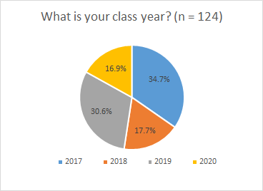

Slide 4
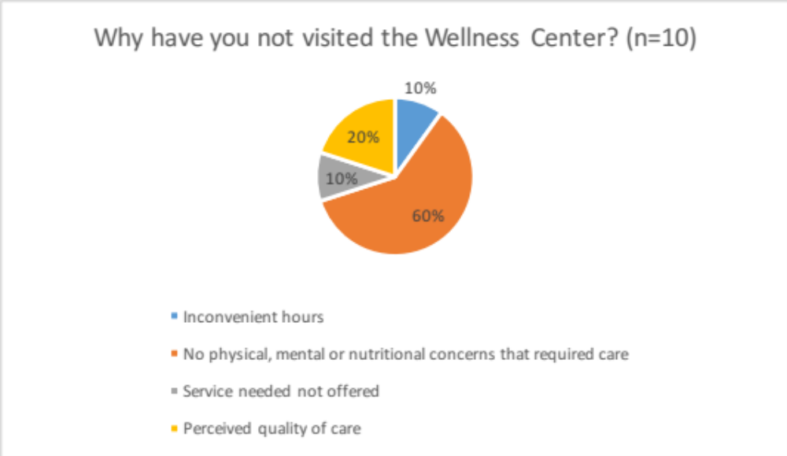

Slide 5
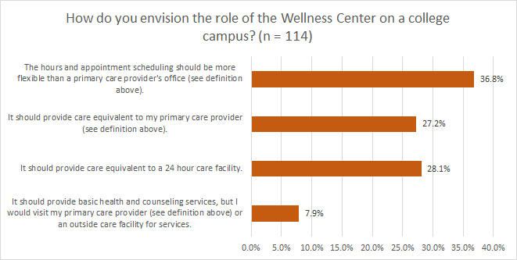

Slide 6
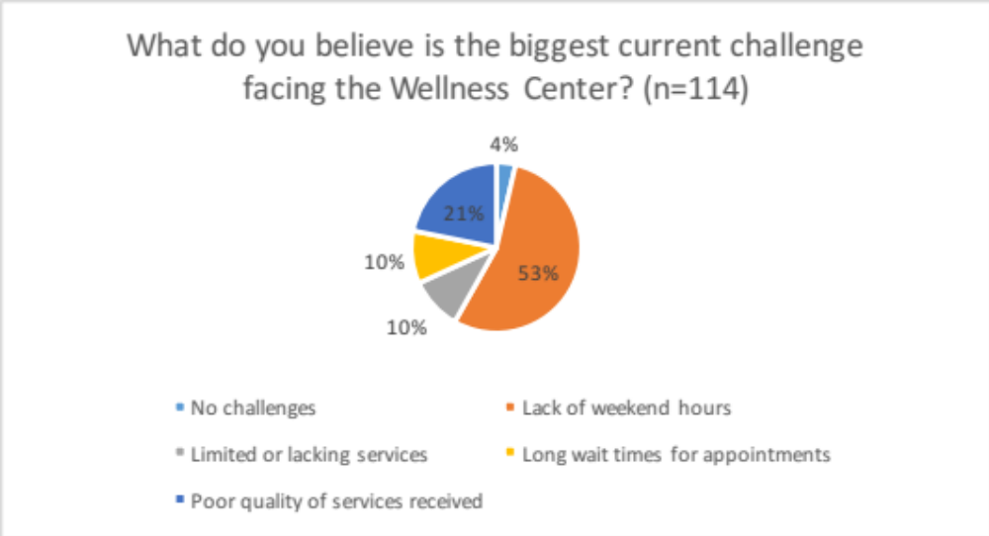

Slide 7
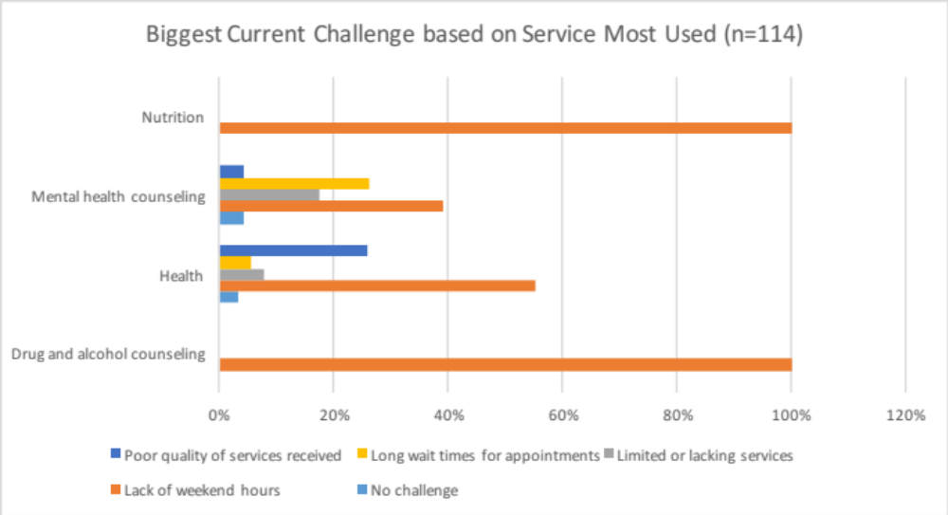

Slide 8
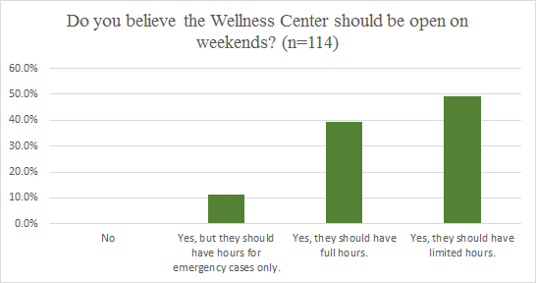

Slide 9
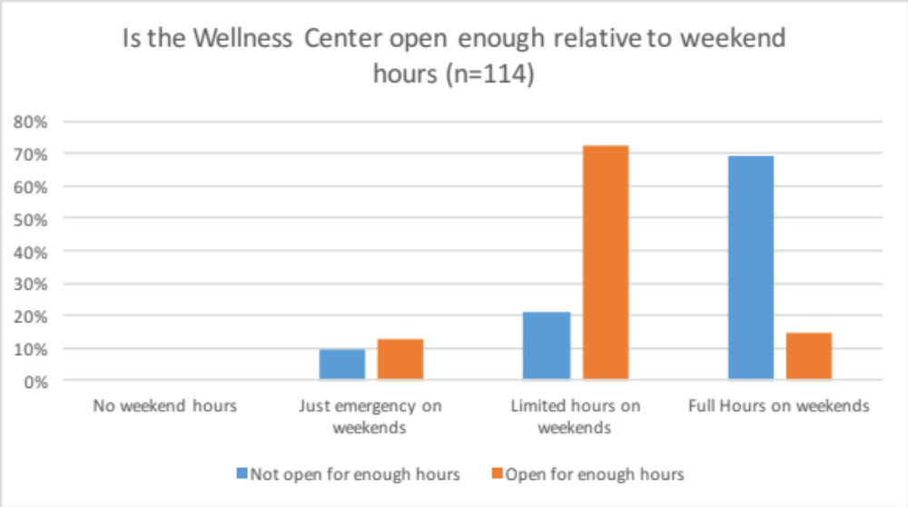

Slide 10
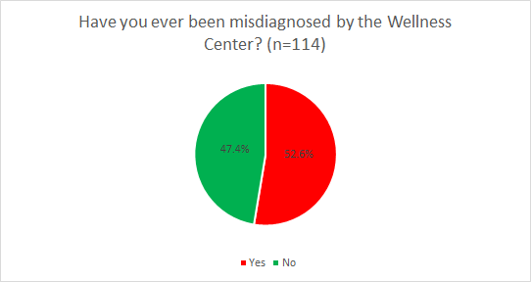

Slide 11
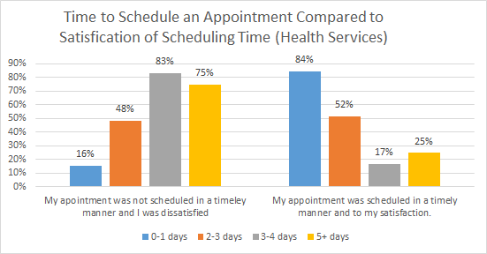

Slide 12
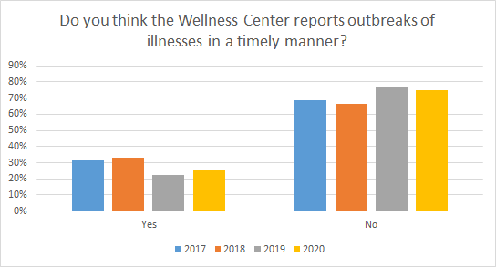

Slide 13
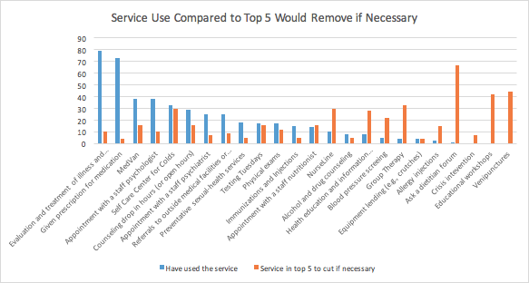

Slide 14
Take Aways
Students want weekend hours of some kind
Attention is needed to quality of care overall, but especially in health services
Outbreaks of illnesses should be reported in a more timely manner

