Slide 1
Wellness Survey
Student Attitudes on Wellness Services
Isabel Lamb and Sally Matlock

Slide 2
Definition of Wellness Center
The Wellness Center is defined as all health, counseling and psychiatric, and nutrition services, and all related programs that are offered by Wellness Center staff.
Notes:
Sally

Slide 3
What is the purpose of our survey?
Our survey wanted to examine:
Which services of the Wellness Center are used by Dickinson students
How satisfied they are with the services
How the Wellness Center could better serve the Dickinson community
Notes:
Isabel
We addressed these goals through a series of questions, some of which are on the next slide. We felt that our set of questions was fair and did not lead the students to feel any particular way about the Wellness Center and our responses seemed to show enough variety to assume we did not present leading questions.

Slide 4
Sample Questions
How do you envision the role of the Wellness Center on a college campus?
Have you ever been required to attend a Wellness Center service? Please check all that apply.
How often do you utilize wellness center services?
On a scale of 1 to 10, how satisfied were you with the health services you received? (1 as least satisfied, 10 as most satisfied)
When scheduling an appointment for health services, do you feel that you are seen in an appropriate amount of time?
How long did you have to wait for an appointment?
Notes:
Sally

Slide 5
Comparison of Actual Student Body and Respondents
Notes:
sally

Slide 6
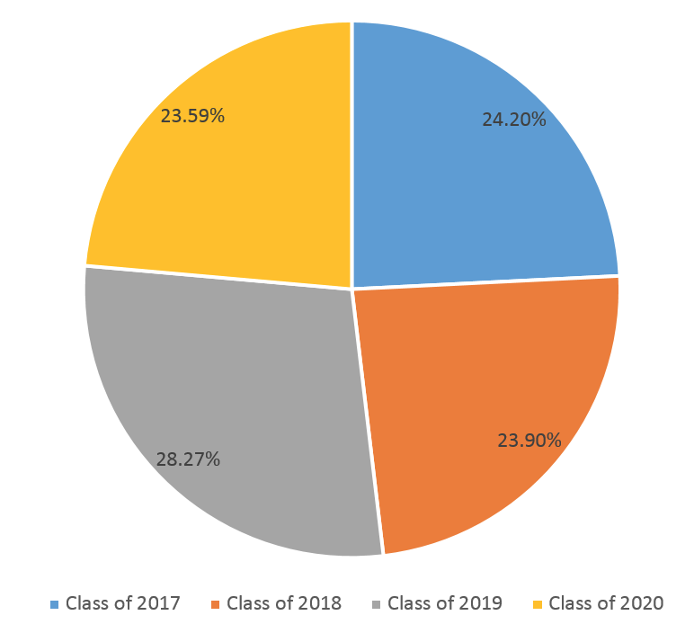
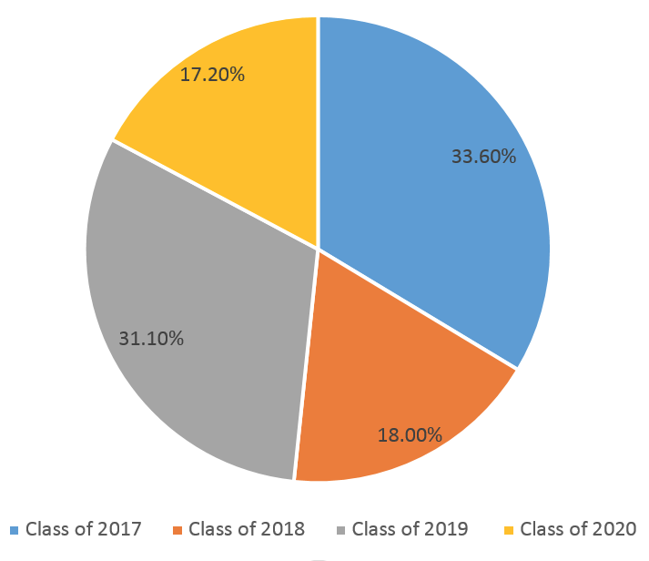
Makeup of Student Body (Class Year)
Actual Class Year Percentages
Survey Respondents Class Year
Notes:
Dickinson’s study body is made up with approximately 2,586 students.

Slide 7
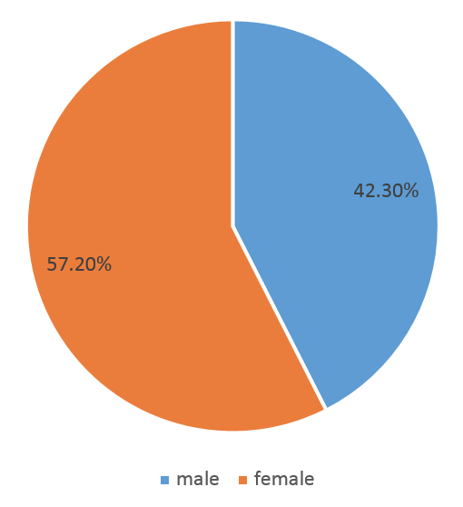
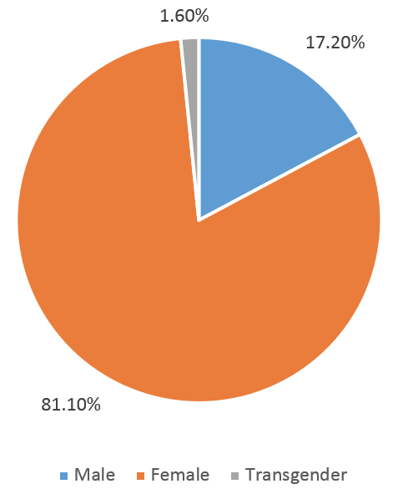
Makeup of Student Body (Gender)
Survey Gender Ratio
Actual Gender Ratio
Notes:
42.3% male; 57.2% female

Slide 8
Visiting the Wellness Center
Notes:
sally

Slide 9
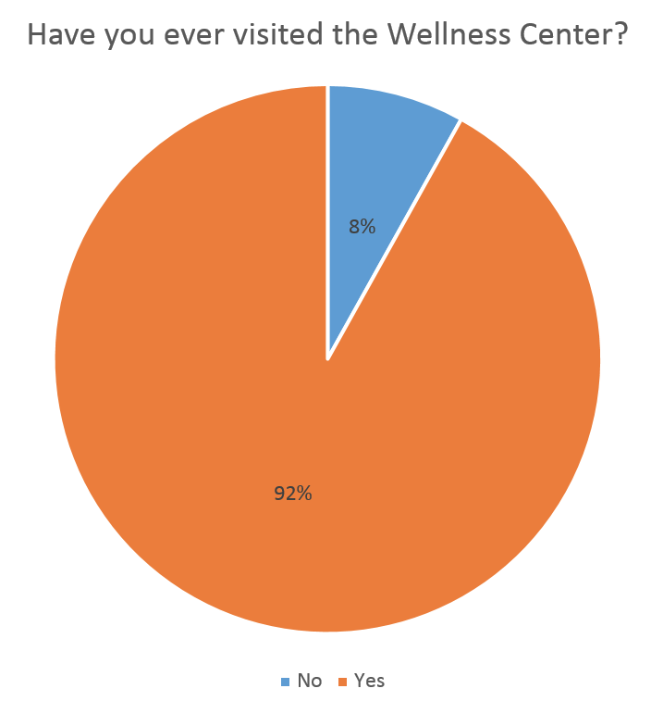
Have You Ever Visited the Wellness Center?

Slide 10
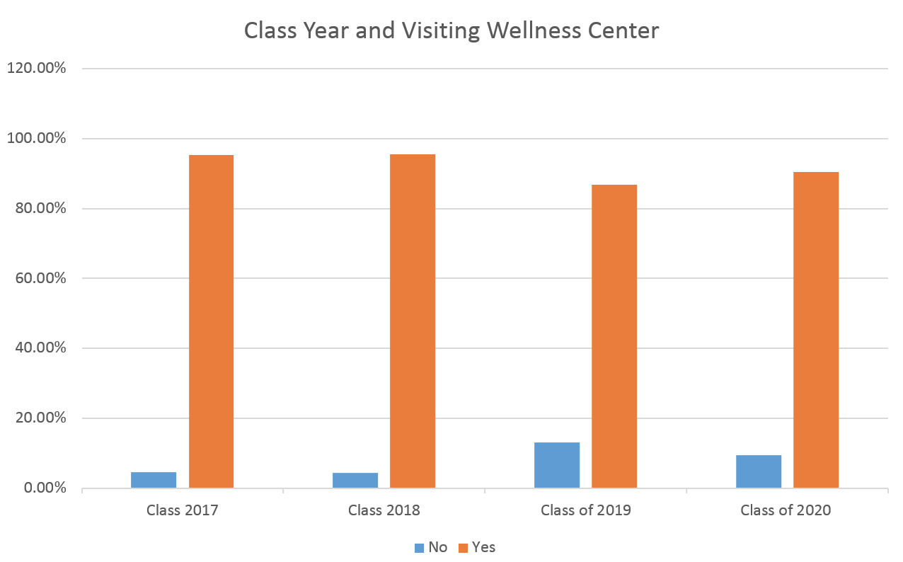
Class Year and Visiting the Wellness Center
Chi-square: .487

Slide 11
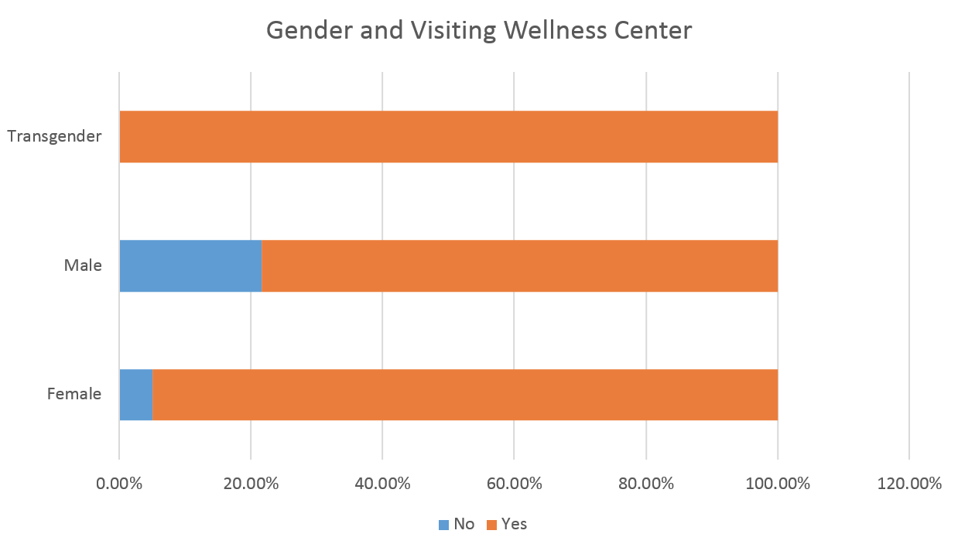
Gender and Visiting the Wellness Center
Chi-square: .027
Notes:
STATISTICALLY SIGNIFICANT DING DING DING

Slide 12
Frequency of Visitation to Wellness Center
Notes:
sally

Slide 13
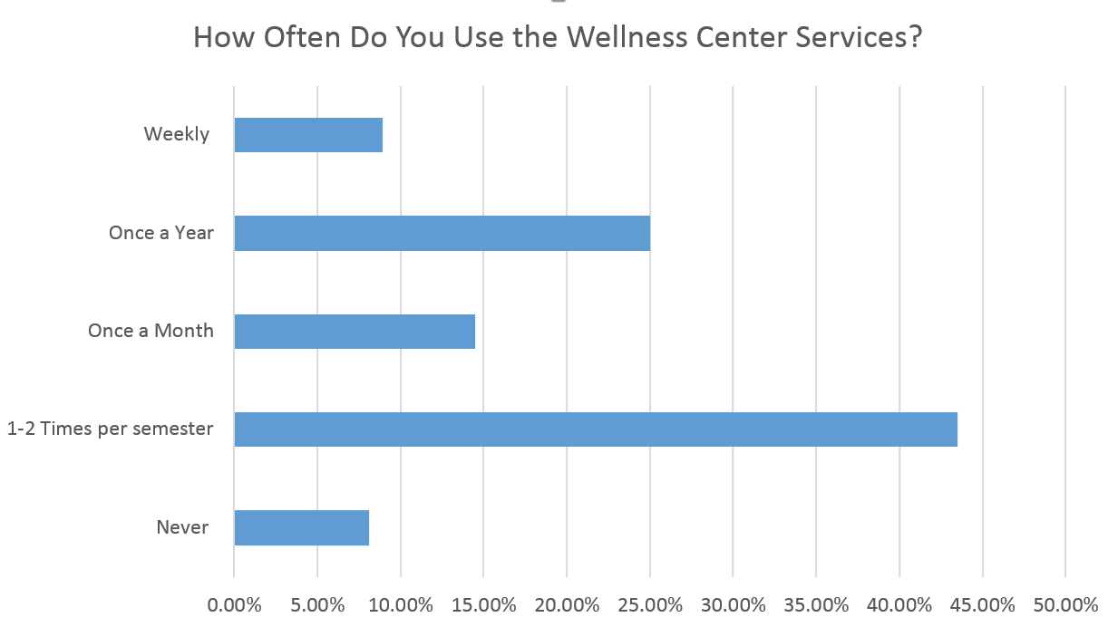
How Often Do You Visit the Wellness Center

Slide 14
Satisfaction with the Wellness Center

Slide 15
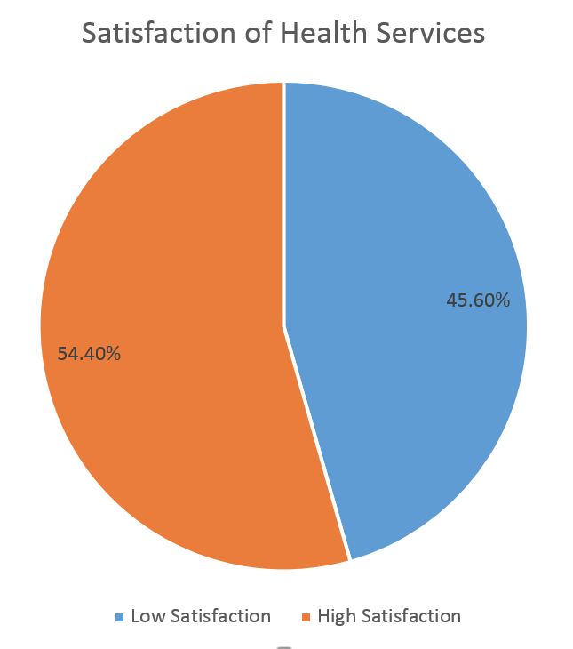
Overall Satisfaction
Notes:
sally

Slide 16
Student Suggestions and Comments
“Weekend services!”
“On campus dermatology”
“More mental health counselors”
“Better evaluation and funding by the school”
“Walk-in appointments”
Notes:
Isabel
Part of our survey included spaces for students to explain their thoughts and give us feedback in open text boxes regarding what they thought should be changed as a result of their satisfaction. These are just a few of the comments we received. We saw that the need for more mental health counselors and appointments was one of the strongest and most foudn conclusions. Weekend services were also quite consistent

Slide 17
Wait Time for Appointment
Notes:
isabel

Slide 18
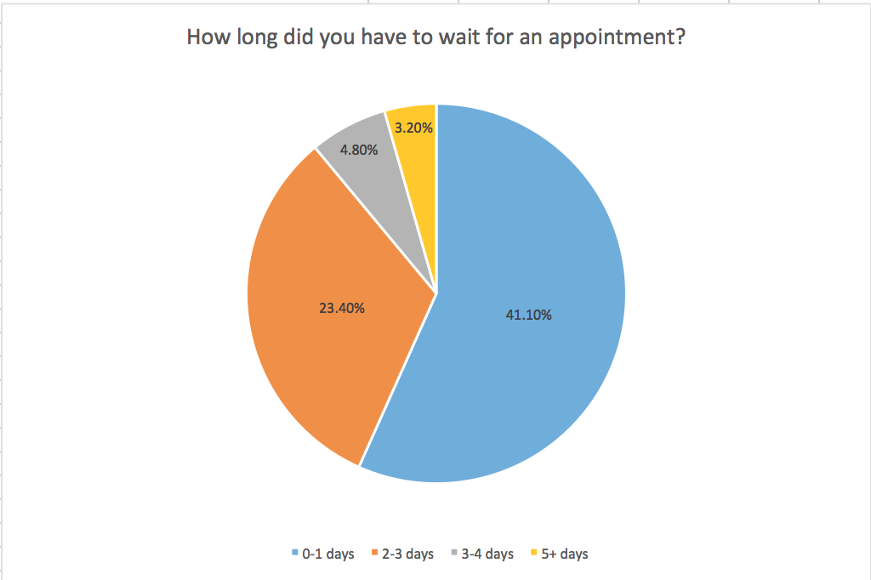
Overall Wait Times
Notes:
iz

Slide 19
How Do You Envision the Role of the Wellness Center
Notes:
isabel

Slide 20
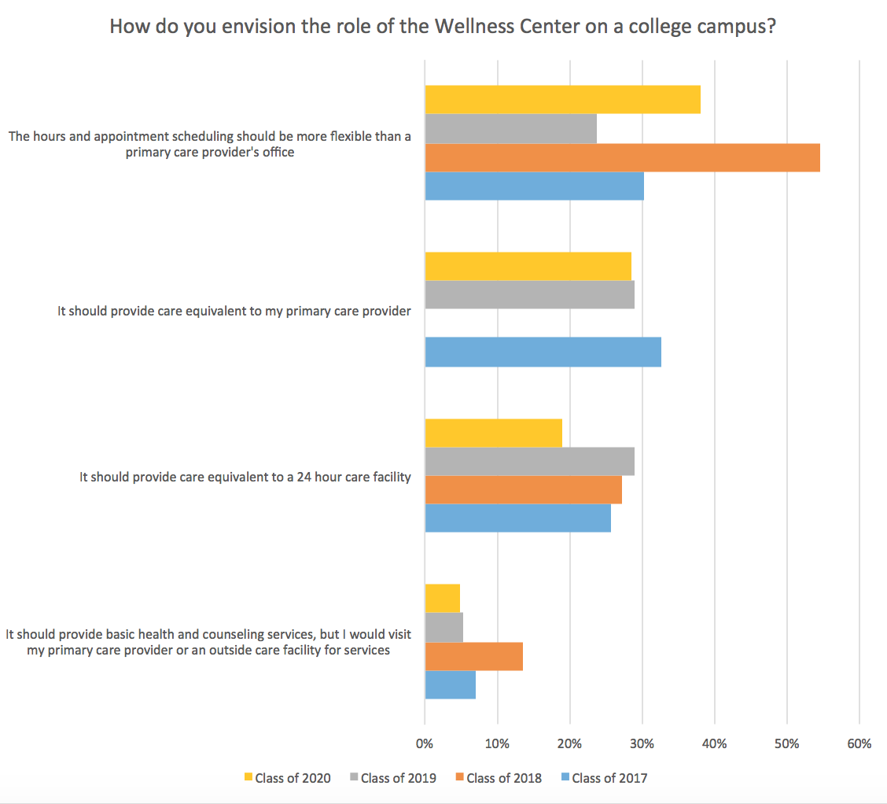
Envisioning the Wellness Center
* For the purpose of this question, we defined, “primary care provider” as, “similar to a doctor’s office: open 9am-5pm, Monday-Friday, where an appointment is required.”
Notes:
Iz

Slide 21
Methodology
Number of Respondents: 122
The margin of error: 8.7
The range of dates: 3/27 to 4/10
Information on the methodology:
Possible over representation of Greek Life
Reached out via GroupMe, Facebook, Email
81.7% Female
Why online?
Notes:
The survivors were made of Vinny Palladino, Isabel Lamb, Philip Morabito, and Sally Matlock. Isabel, Sally, and Vinny are all involved with a Greek organization on campus, thus the three Greek organizations Kappa Kappa Gamma, Delta Nu, Delta Sigma) could be over represented. All four members reached out to Dickinson Students via Groupme, Facebook, or email. With 81.1% of the people taking our survey identifying as women, the statistical significance of anything gender related was lowered. The survivors agreed that because the topic touched on private issues of physical and mental health, an online forum would receive the most honest answer and create a comfortable environment for the takers of the survey.

Slide 22
Work Cited
Dickinson College, Quick Facts, 2017 dickinson.edu/info/20048/history_of_the_college.
Accessed 20 Apr. 2017.

