Slide 1
Dickinson Housing Policies and Procedures
By: Kass Lesher and Kelly O’Hern

Slide 2
Overview
Present sophomores, juniors, and seniors opinions towards Housing on Dickinson College campus
We created a survey consisting of 22 multiple choice, fill in the blank and interval questions
We were surprised to find that most students who took this survey seemed to be satisfied with housing
Survey: https://docs.google.com/forms/d/1r0Gw1zbkcMgK8u3s5L1ysjEPWzKZrOPLlKo2G9d7sTQ/edit

Slide 3
Methodology
Number of Interviews: 103 respondents.
Margin of Error: +/- 9.66% at a 95% level of confidence. Larger sample sizes have smaller margins of error.
Date: Survey was in the field from March 30th to April 10th
Method of Survey: All surveys were conducted online through a google forms survey. Each member of our group sent out the survey through a link to our sororities, sports teams and friends who we knew would be interested in the topic we were surveying. We sent the link through social media (Facebook) and email, and the survey was completely voluntary. Additionally, we only asked sophomores, juniors and seniors to fill out the survey. Upon completion, the respondents would submit their survey and the data was immediately collected through google forms.

Slide 4
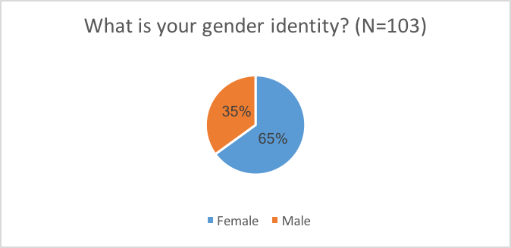
Descriptive Statistics: Univariate

Slide 5
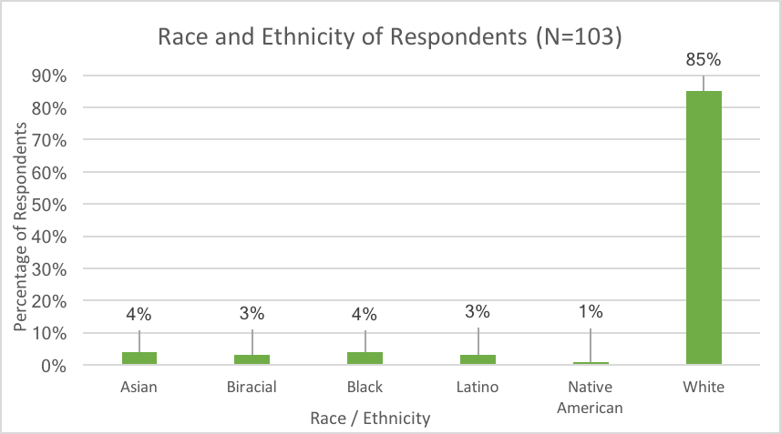

Slide 6
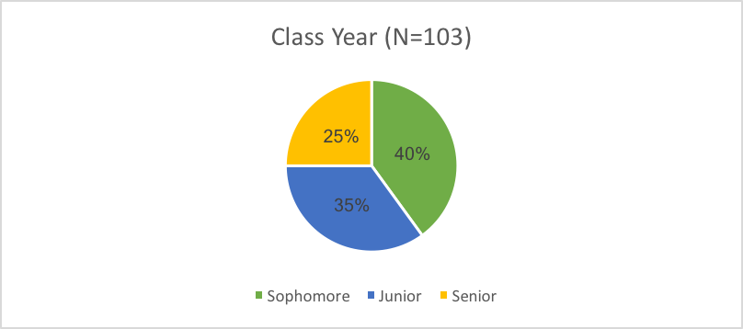

Slide 7
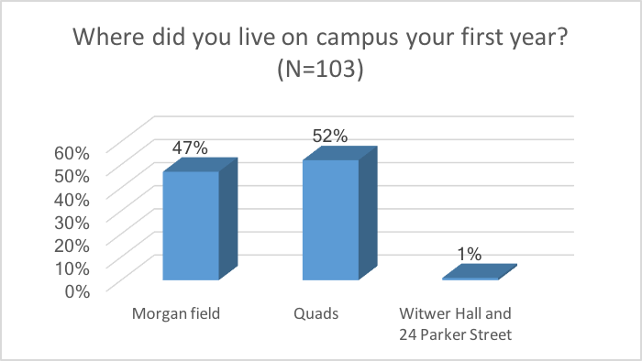

Slide 8
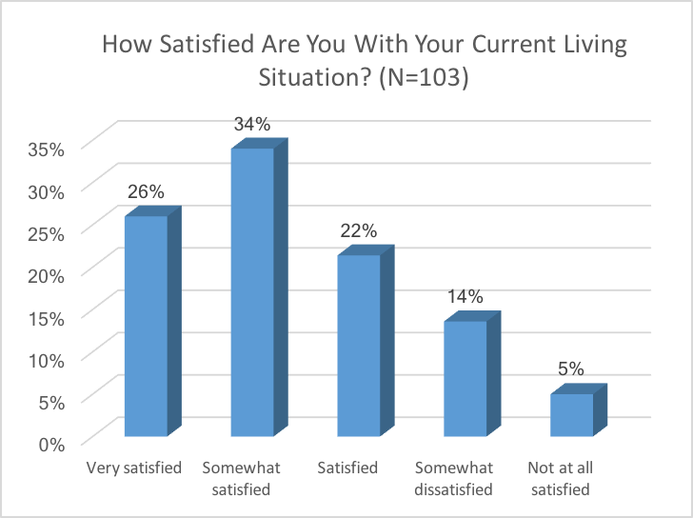

Slide 9
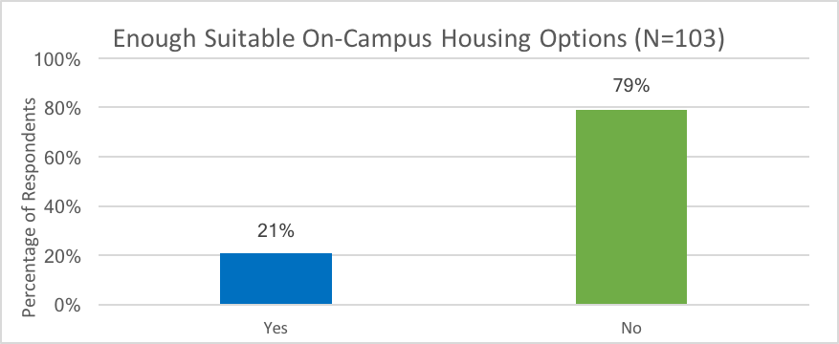

Slide 10
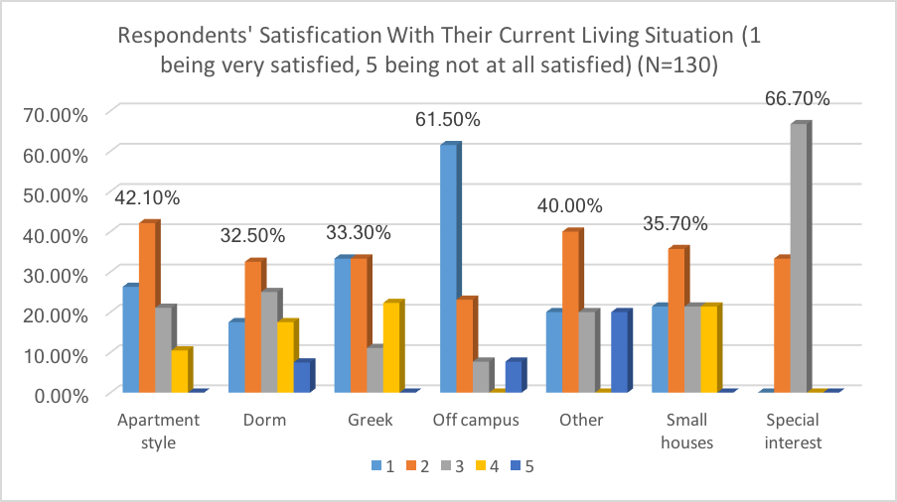

Slide 11
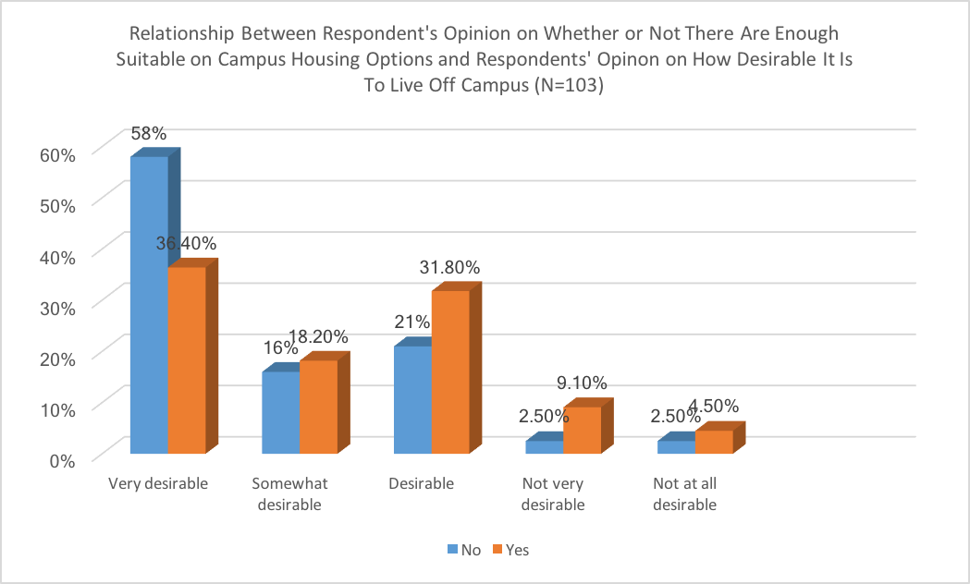

Slide 12
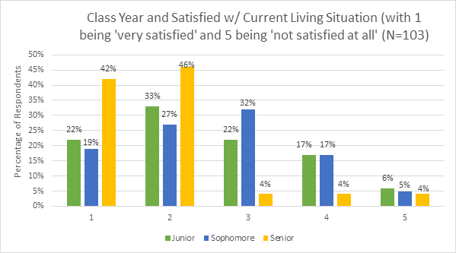

Slide 13
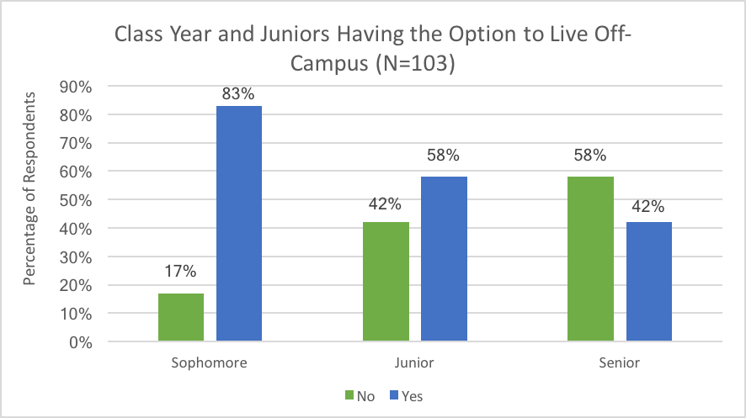
Statistically Significant: Chi-square = .002

Slide 14
Alternatives / In the Future
Larger sampling size
  Including freshman
Race / Ethnicity
Gender
New dorm

