Slide 1
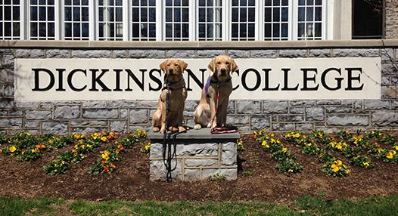
Engagement and Inclusivity at Dickinson College
Carissa Jimenez
Adam (Chuling) Huang
POSC244

Slide 2
Methodolgy
Number of Interviews: 76 students.
Margin of Error: +/- 11.06 at a 95% level of confidence.
Date: March 20th to April 13rd.
Methods of Interviewing: the survey was done through Google Forms online. Participants came from various groups across campus and were recruited mainly through inviting Facebook friends,sending emails, and asking friends personally.

Slide 3
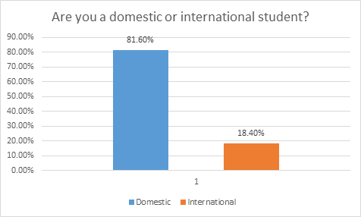
International/ domestic student
Accurate data shows that 10% of Dickinson students are international student.
In this survey, international students over-represent the sample.

Slide 4
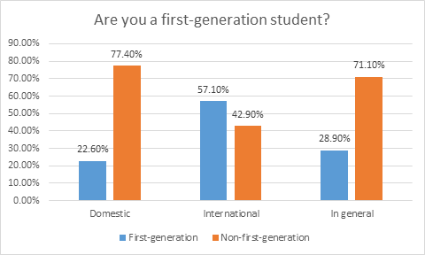
First-generation & international/domestic
Comparing to domestic student, a much higher percentage of international students are first-generation student.
P-value of 0.01 means that it’s statistically significant.
Notes:
Implication: being an international student and being a first-generation student can both give student a hard time in college. What this survey found out is that many international students are also first-generation students, which might give them a even harder time in Dickinson.

Slide 5
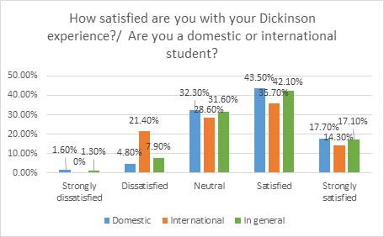
Dickinson Experience & international/domestic
Comparing to domestic students, international students have a higher percentage of dissatisfaction rate.
P-value of 0.342 means that it’s not statistically significant.
Notes:
Even though the p-value is not significant, we can still see a remarkable difference between international and domestic students in dissatisfaction rate. The small sample size might cause it to be insignificant.

Slide 6
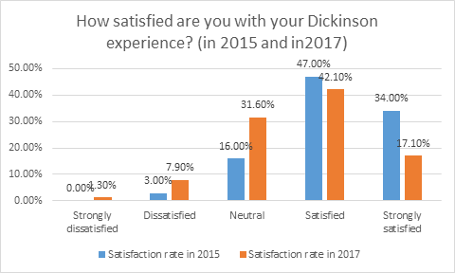
Student satisfaction rate& 2015 and 2017
Comparing to year 2015, students have a lower satisfaction rate in year 2017. Significant amount of students chose neutral.
However, there could be several external reasons: priming and class year.
Notes:
Class year: 70.3% lowerclassmen and 29.7% upperclassmen; I assume upperclassmen are likely to have higher satisfaction rate (if they don’t like Dickinson, they had the chance to transfer) and lowerclassmen relatively lower satisfaction rate, that might have pulled down the satisfaction rate.
Priming: several questions right before this question ask about exclusivity, feeling of belonging and relationship with fellow Dickinsonians. That might create a heavy atmosphere and push students to choose negetively (neutral), especially the word “exclusive”. After studying the questions, I found out that they generally have the same pattern of response; it’s possible that many students simply followed their choice in the prior question.

Slide 7
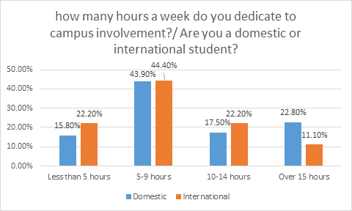
Hours dedicated to campus involvement
We don’t find significant difference between international and domestic student in regard to the hours they spent on campus involvement; international students are just as active as domestic students.

Slide 8
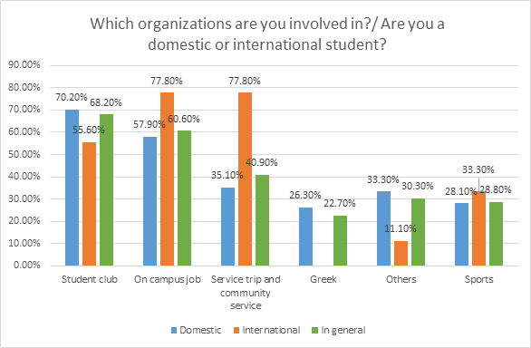
What organization are you involved in?/international & domestic
Two findings:
First, international students are much more involved in service trip and community service. P-value 0.015.
Second, domestic students are much more involved in Greek life. P-value 0.08
Notes:
Implication: I think both community service culture and Greek culture are typical American culture. According to the survey, Dickinson international students adapt the first one much better than the second. There could be many reasons: maybe community service culture is not as unique as Greek culture

Slide 9
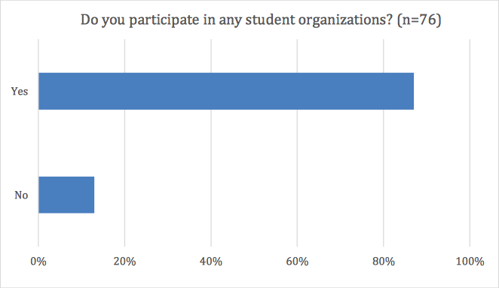
Do you participate in any student organizations?

Slide 10
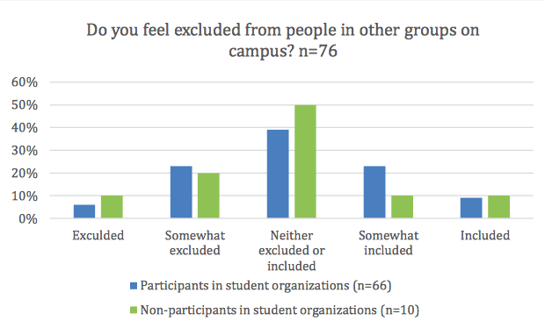
Do you feel excluded from people in other groups on campus?
This shows that it does not matter if a student is in an organization; they will still get the same relationship with others on campus if they decided not to be involved in any clubs.

Slide 11
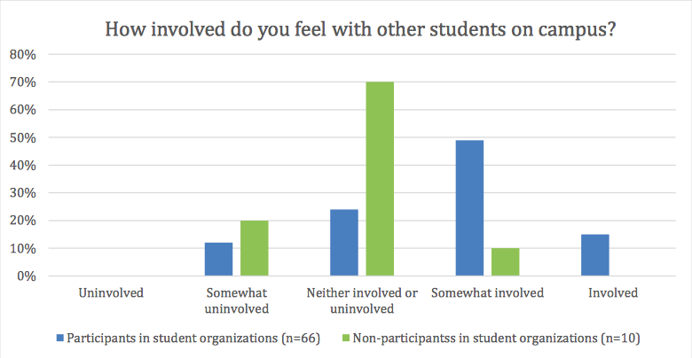
How involved do you feel with other students on campus?
The results of this graph is actually statistically significant. Although the question may be similar to the question I discussed earlier about exclusion and the relationship with other students on campus, there is a significant plurality response from the participants and nonparticipants.
Notes:
The 70% of those who do not participate in student organizations feel that they are neither involved nor uninvolved with other students on campus, with less than 30% of people involved in organizations feeling the same way. 10% more people who are not in student organizations felt more somewhat uninvolved than somewhat involved as well, with none of them actually feeling completely involved. There is also a significant difference with the answers of being somewhat involved. About 50% of participants feel that they are somewhat involved while only 10% of non-participants feel that they are. On the other hand, about 70% of club participants feel somewhat involved and involved with other students. This shows that if a student were to not be in an organization on campus, they are more likely to feel indifferent about being involved or uninvolved with other students on campus, rather than those who in clubs.

Slide 12
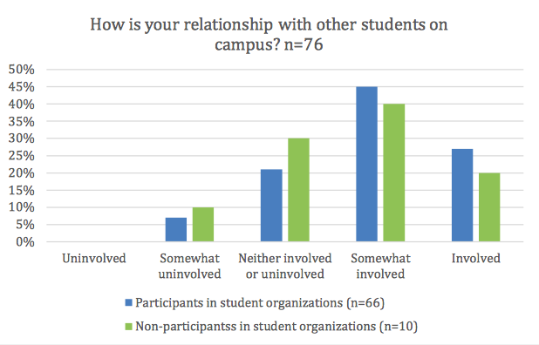
How is your relationships with other students on campus?
There was not much of a difference in answers between club participants and nonparticipants when asked about their relationship with other students on campus. Not everyone will know everyone on campus, so the results make sense.
Notes:
The plurality of both groups answered that they felt somewhat involved with other students on campus. Only a few student felt somewhat uninvolved and no one had felt completely uninvolved.

Slide 13
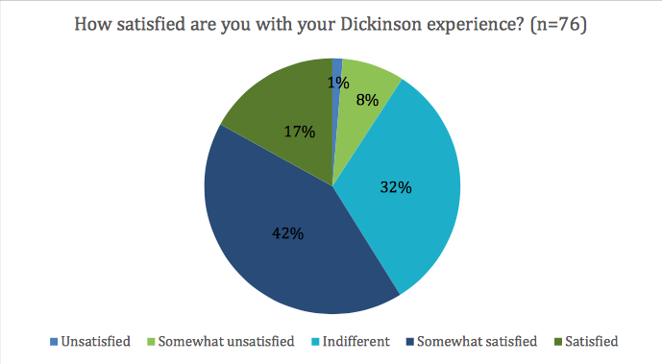
How satisfied are you with your Dickinson experience?
What stood out to me in particular is that many 32% were indifferent about their experience. I personally think that if I go to the college that I committed to, I would want to have the best experience, so it really surprised me to see that people were not satisfied nor unsatisfied with Dickinson.

Slide 14
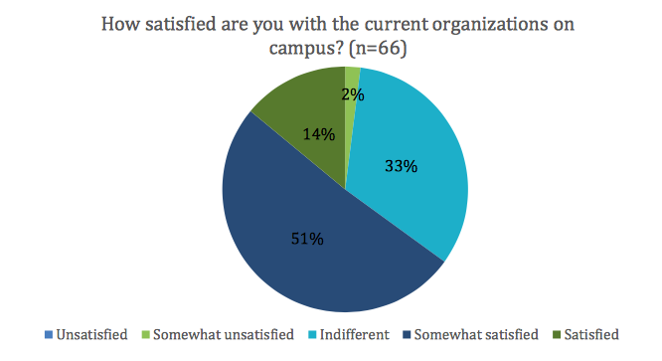
How satisfied are you with the current organizations on campus?
We found that there really was not much of a difference in responses from both participants and nonparticipants. We also asked if they feel excluded from people in other groups on campus, and also got similar answers from the two groups.
Notes:
This shows that it does not matter if a student is in an organization; they will still get the same relationship with others on campus if they decided not to be involved in any clubs.

