Slide 1
Dickinson College and the Carlisle Community
Jen Ailey (‘19) and Caitlin Healy (‘19)
12 May 2017
Public Opinion and Survey Research

Slide 2
Methodology
Number of respondents: 90 students at Dickinson College
Margin of error: +/- 11.8
Range of dates of which the survey was in the field: March 27th through April 10th
Methods of interviewing: Our group sent our survey to friends and fellow classmates at Dickinson College and posted the link to the survey in the Kappa Kappa Gamma sorority of Dickinson College Facebook page.

Slide 3
Gender and Residence
93.3% female
5.6% male
1.1% trans
43.3% in on-campus apartments/townhouses
40% in on-campus residence halls
6.7% in special interest housing
5.6% in off-campus housing
4.4% in greek life housing

Slide 4
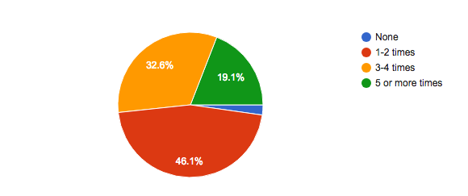
How many times a week do you enter downtown Carlisle?

Slide 5
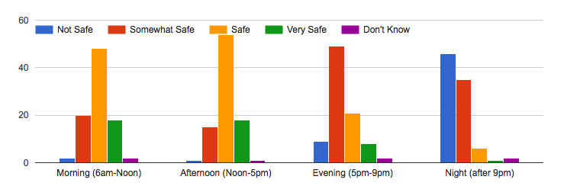
How safe do you feel OFF campus during the following times?

Slide 6
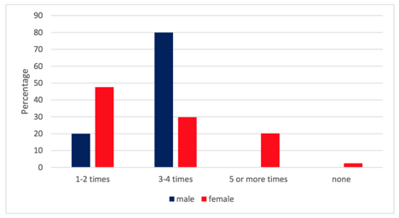
What is your gender identity and how many times a week do you enter downtown Carlisle?

Slide 7
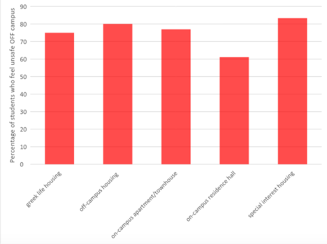
Where do you reside and have you ever felt that your safety has been compromised while OFF campus?

Slide 8
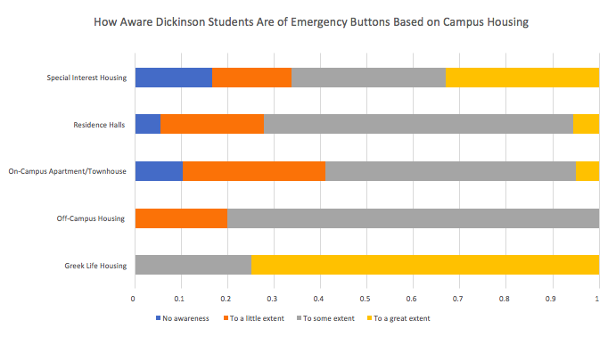
Where do you reside and how aware are you of the emergency button?

Slide 9
Conclusion
What we found interesting
Off-campus housing has a just as, if not more, knowledge on the emergency buttons - Assumed because the farther off campus the less aware one would be
Significant relationships
Frequency entering Carlisle and gender - As the frequency of entering Carlisle increases, the percentage of females decreases - inverse relationship

