Slide 1
PARTY IDENTIFICATION
AMARA ROJO AND ALEXIE MURIEL

Slide 2
Methodology
Date: November 6, 2018
Number of Interviews:
1,307 voters in Allegheny, Cumberland, and Lehigh Counties, Pennsylvania.
Margin of Error:
+/- 2.7% at a 95% level of confidence. Margins of error for subgroups will be larger than for the full survey
Methods of Interviewing:
All interviews were conducted in person, but were anonymous. Upon exiting the polling place, voters were asked if they wanted to participate. If voters agreed, they were given a clipboard with the survey and asked to complete both sides of the questionnaire. Upon completion, surveys were places in envelopes with precinct identifiers.
Interviews of Cumberland County voters were conducted by Dickinson College students under the direction of Professor Sarah Niebler. For further information, please contact Professor Niebler at: nieblers@dickinson.edu; or 717-254-8093.

Slide 3
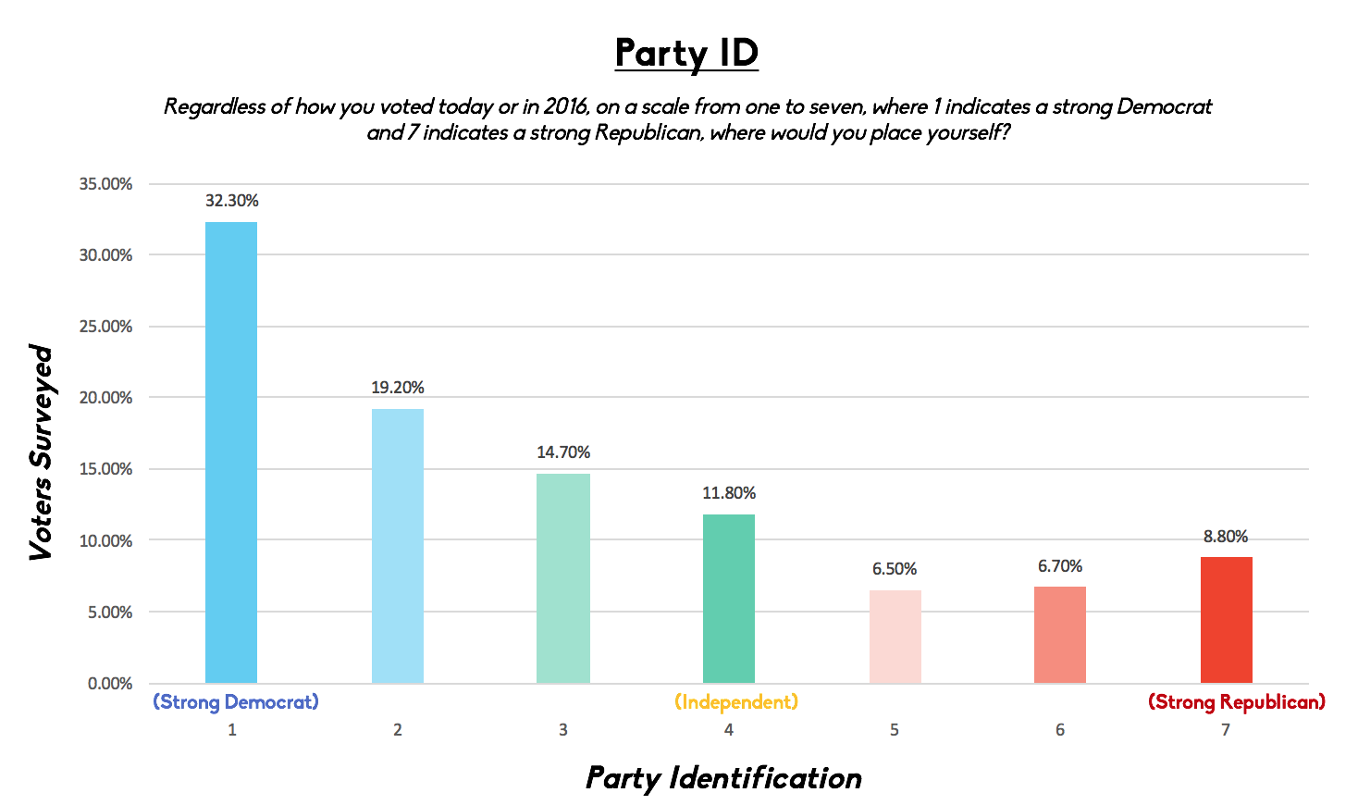

Slide 4
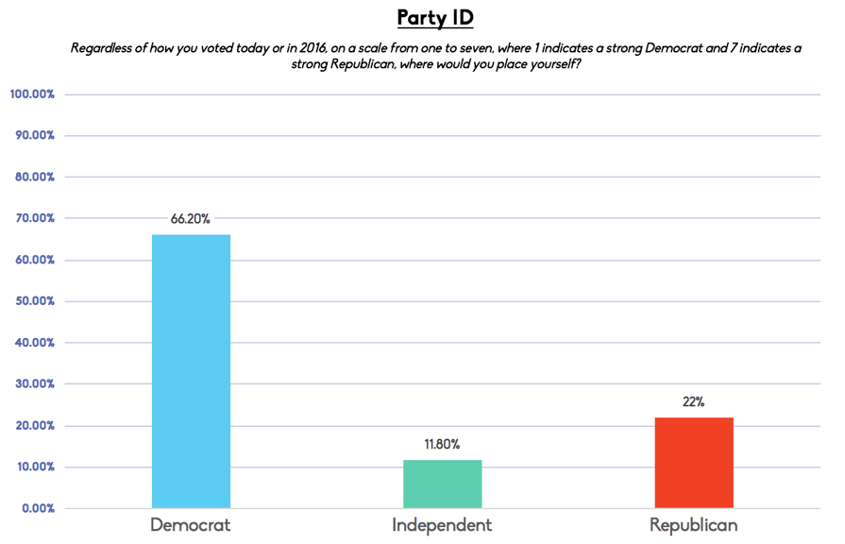

Slide 5
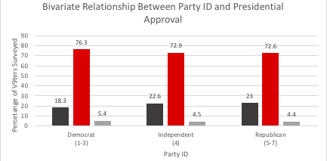

Slide 6
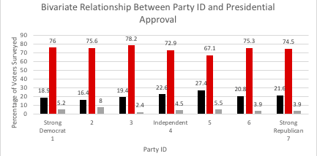

Slide 7
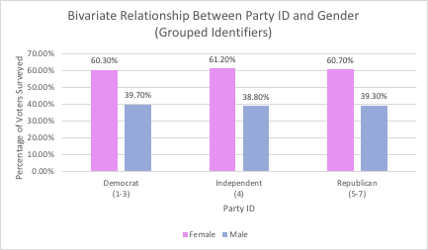

Slide 8
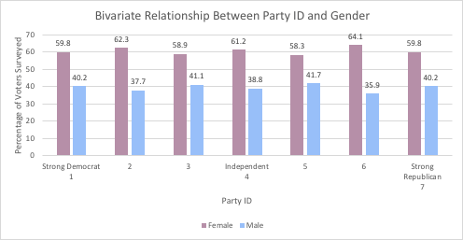

Slide 9
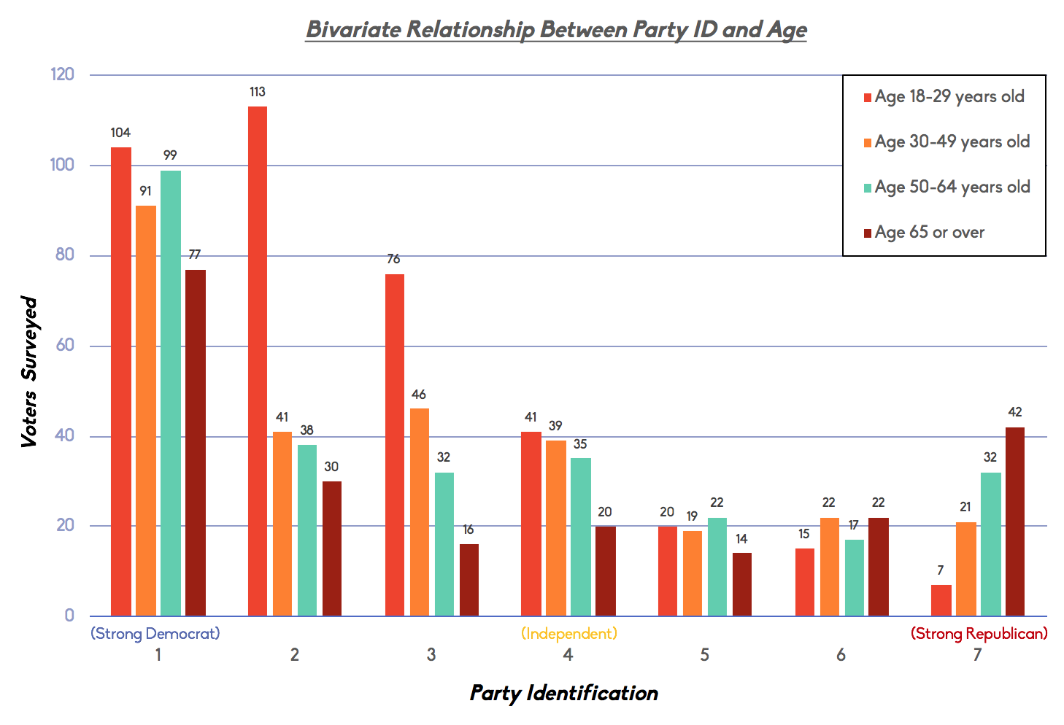

Slide 10
