Slide 1
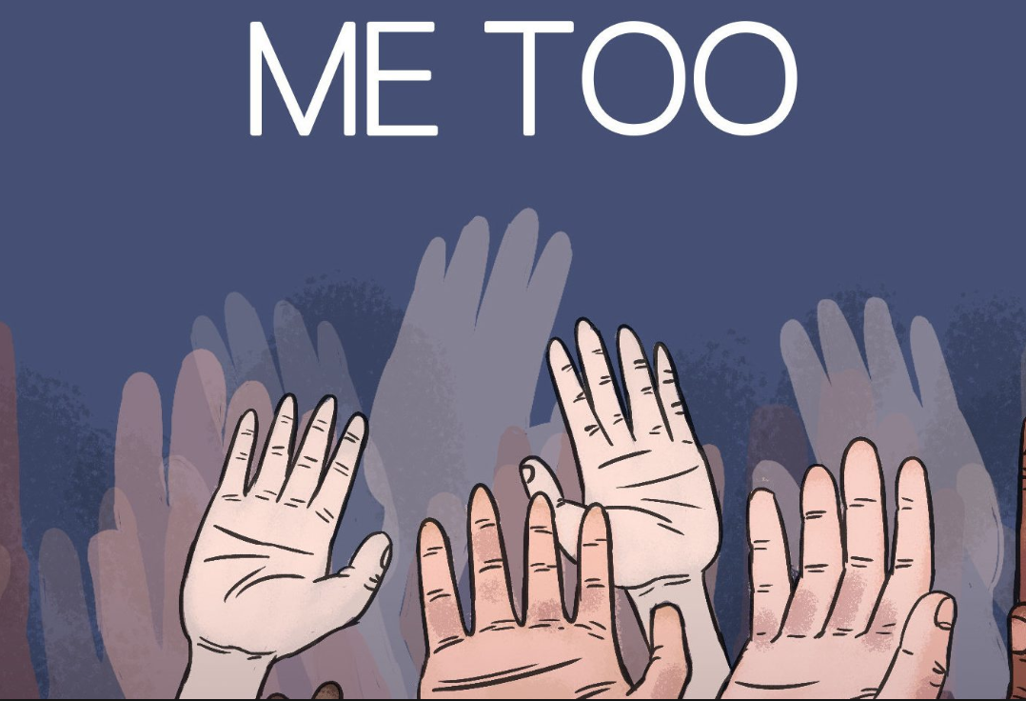
#MeToo
By: Maddie Parker & Sam Marmo
Notes:
Main Question: do you have a favorable or unfavorable view of the #Metoo movement against sexual assault?
Sam:
Ideology
Kavanaugh
Maddie:
Gender
#Me too Personal
Computers with SSP:
Denny 112
Stern 11
Office Hours:
Thursday, normal
Monday 1:30-3:30 pm
Wednesday 10-12 pm

Slide 2
Methodology
Date: November 6, 2018
Number of Interviews: 1,307 voters in Allegheny, Cumberland, and Lehigh Counties, Pennsylvania.
Margin of Error: +/- 2.7% at a 95% level of confidence. Margins of error for subgroups will be larger than for the full survey.
Methods of Interviewing: All interviews were conducted in person, but were anonymous. Upon exiting the polling place, voters were asked if they wanted to participate. If voters agreed, they were given a clipboard with the survey and asked to complete both sides of the questionnaire. Upon completion, surveys were places in envelopes with precinct identifiers.
Interviews of Cumberland County voters were conducted by Dickinson College students under the direction of Professor Sarah Niebler. For further information, please contact Professor Niebler at: nieblers@dickinson.edu; or 717-254-8093.

Slide 3
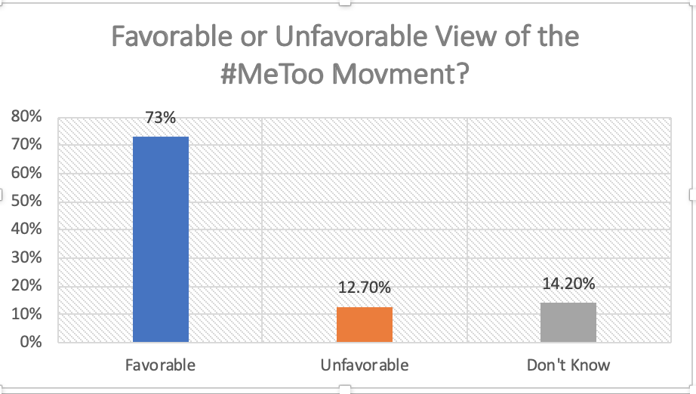
Our Main Univariate

Slide 4
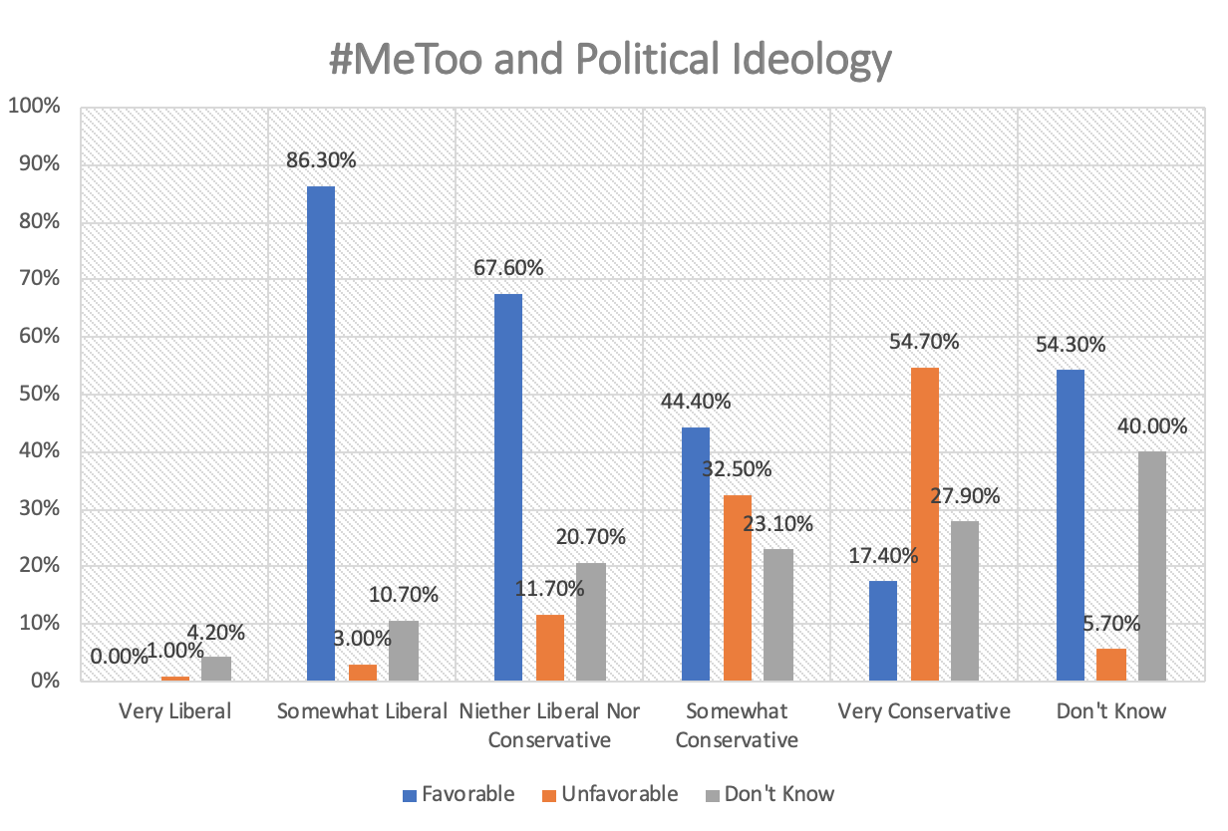
Somewhat Liberal are mostly in favor
Very Conservative oppose the most
Statistically significant

Slide 5
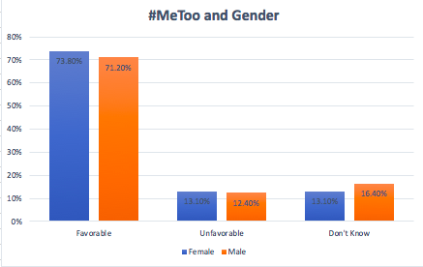
Both females and males favored the movement at very high rates
Not statically significant

Slide 6
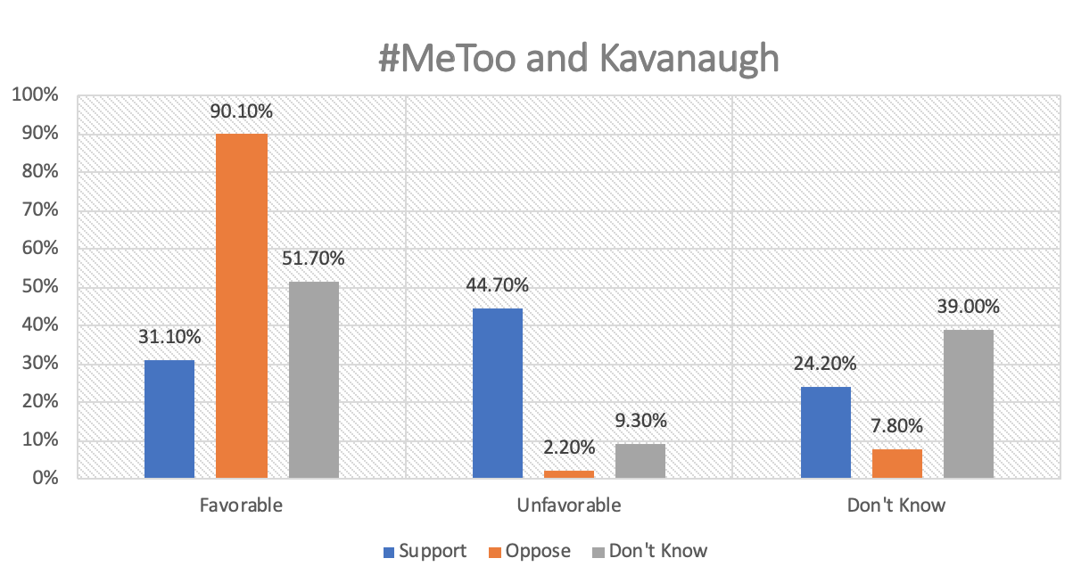
Favorable of #Metoo = Oppose Kavanaugh
Unfavorable of #MeToo = Support Kavanaugh
Statistically significant

Slide 7
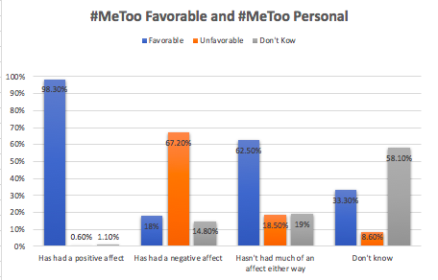
Respondents who favored the movement also said it has had a positive effect on them
Respondents who had an unfavorable view said it had a negative effect on them
Statistically significant

Slide 8
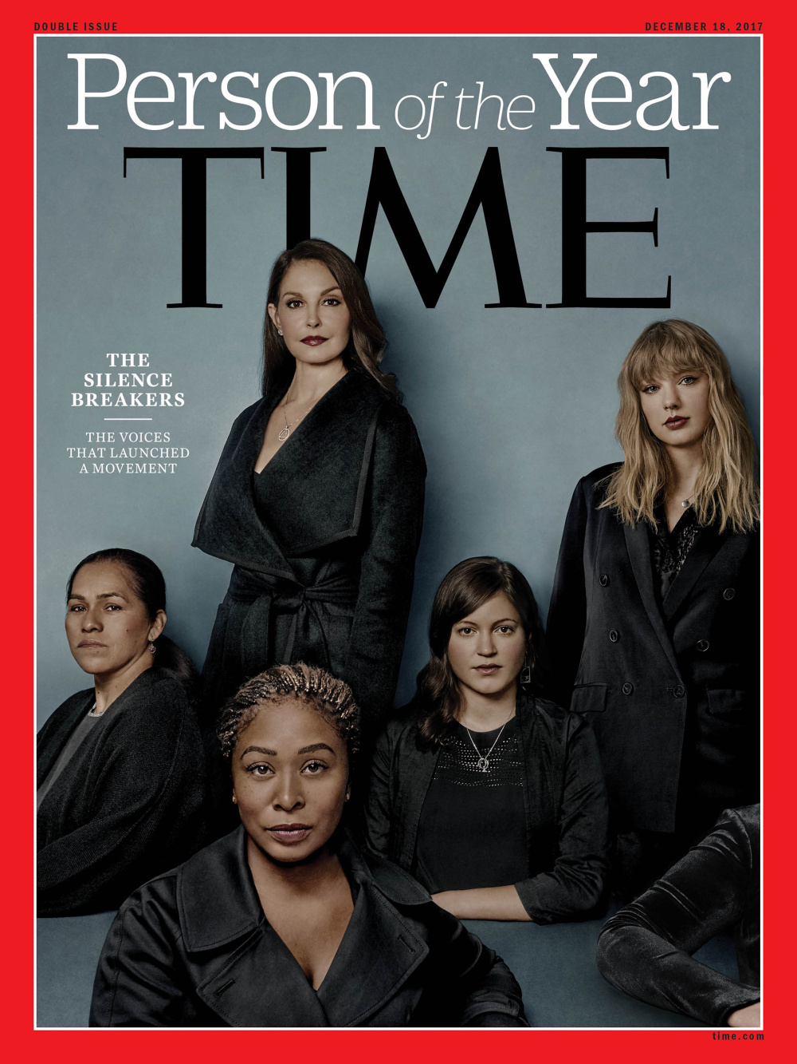
Conclusion

