Slide 1
State of the Economy
Anthony Francioso and Austin Seabolt

Slide 2
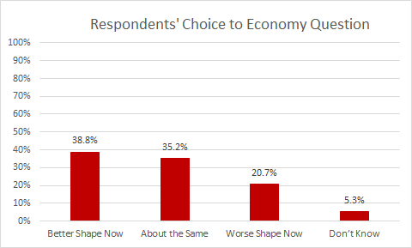
Univariate Statistics: Economy Question
Survey question was, "Would you say the country's economy is in better shape now than it was a few years ago, about the same, or in worse shape now?"
(N = 1178)
Respondent's Choice | Valid Percent
Better Shape Now | 38.8%
About the Same | 35.2%
Worse Shape Now | 20.7%
I Don't Know | 5.3%
Source: PA Collegiate Exit Poll, Fall 2018

Slide 3
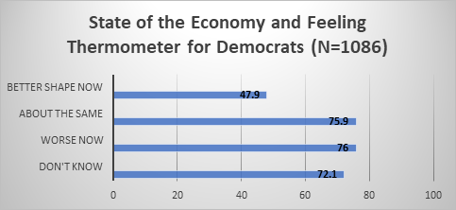
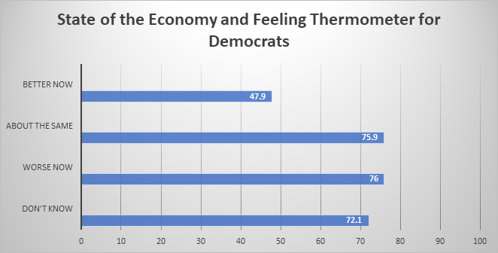
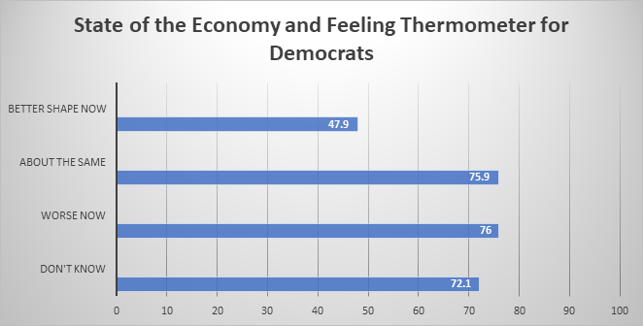
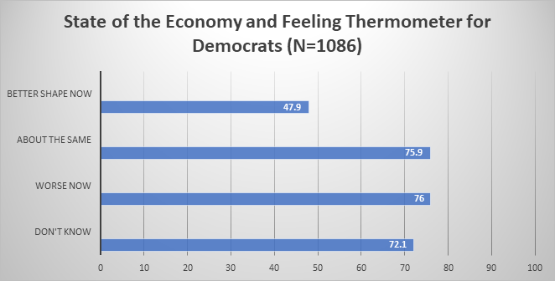
Bivariate Relationship: Economy and Democrats
Survey Question asked respondents to assign a rating of 0-100 to the Democratic Party. 0 degrees means you feel as cold and negative as possible. A rating of 100 degrees means you feel as warm and positive as possible.
(N=1086)
ANOVA Test Significance: .000
Source: PA Collegiate Exit Poll, Fall 2018

Slide 4
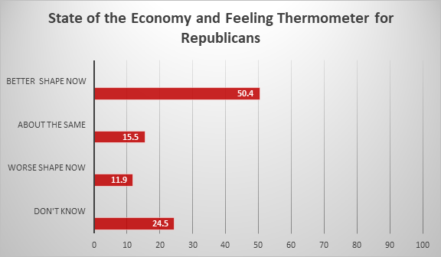
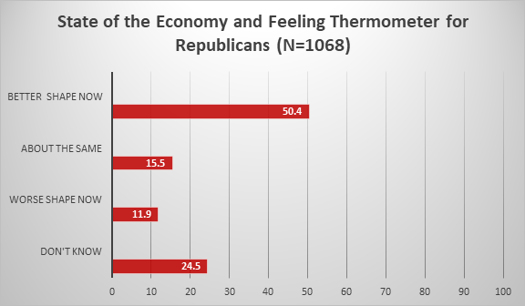
Bivariate Relationship: Economy and Republicans
Survey Question asked respondents to assign a rating of 0-100 to the Republican Party. 0 degrees means you feel as cold and negative as possible. A rating of 100 degrees means you feel as warm and positive as possible.
(N= 1068)
ANOVA Test Significance: .000
Source: PA Collegiate Exit Poll, Fall 2018

Slide 5
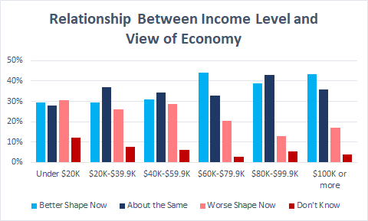
Bivariate Relationship: Economy & Income Level
Survey question was, "Which of the following categories best describes your family income?"
 | Better Shape Now | About the Same | Worse Shape Now | Don’t Know | Total
Under $20K | 24 | 23 | 25 | 10 | 82
$20K-$39.9K | 40 | 50 | 35 | 10 | 135
$40K-$59.9K | 60 | 67 | 56 | 12 | 195
$60K-$79.9K | 76 | 57 | 35 | 5 | 173
$80K-$99.9K | 49 | 54 | 16 | 7 | 126
$100K or more | 182 | 151 | 72 | 16 | 421
Total | 431 | 402 | 239 | 60 | 1132
(N=1,132)
ANOVA Test: Significance of .0001
Source: PA Collegiate Exit Poll, Fall 2018

Slide 6
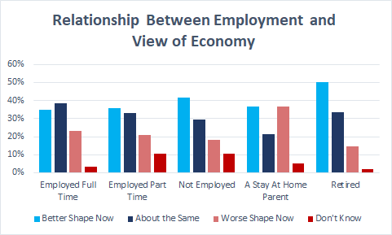
Bivariate Relationship: Economy and Employment
Survey Question was, "Are you currently...?"
 | Better Shape Now | About the Same | Worse Shape Now | Don't Know | Total
EmployedFull Time | 197 | 217 | 131 | 18 | 563
EmployedPart Time | 79 | 73 | 46 | 23 | 221
Not Employed | 55 | 39 | 24 | 14 | 132
A Stay at Home Parent | 7 | 4 | 7 | 1 | 19
Retired | 116 | 78 | 34 | 4 | 232
Total | 454 | 411 | 242 | 60 | 1167
(N=1,167)
ANOVA Test: Significance of .001
Source: PA Collegiate Exit Poll, Fall 2018

Slide 7
Methodology
•Date: November 6, 2018
•Number of Interviews: 1,307 voters in Allegheny, Cumberland, and Lehigh Counties, Pennsylvania.
•Margin of Error: +/- 2.7% at a 95% level of confidence. Margins of error for subgroups will be larger than for the full survey.
•Methods of Interviewing: All interviews were conducted in person, but were anonymous. Upon exiting the polling place, voters were asked if they wanted to participate. If voters agreed, they were given a clipboard with the survey and asked to complete both sides of the questionnaire. Upon completion, surveys were places in envelopes with precinct identifiers.
•Interviews of Cumberland County voters were conducted by Dickinson College students under the direction of Professor Sarah Niebler. For further information, please contact Professor Niebler at: nieblers@dickinson.edu; or 717-254-8093.

