Slide 1
2018 Exit Poll Results
Sarah Lutz and Vernon Cisney

Slide 2
Methodology
•Date: November 6, 2018
•Number of Interviews: 1,307 voters in Allegheny, Cumberland, and Lehigh Counties, Pennsylvania.
•Margin of Error: +/- 2.7% at a 95% level of confidence. Margins of error for subgroups will be larger than for the full survey.
•Methods of Interviewing: All interviews were conducted in person, but were anonymous. Upon exiting the polling place, voters were asked if they wanted to participate. If voters agreed, they were given a clipboard with the survey and asked to complete both sides of the questionnaire. Upon completion, surveys were placed in envelopes with precinct identifiers.
•Interviews of Cumberland County voters were conducted by Dickinson College students under the direction of Professor Sarah Niebler. For further information, please contact Professor Niebler at: nieblers@dickinson.edu; or 717-254-8093.

Slide 3
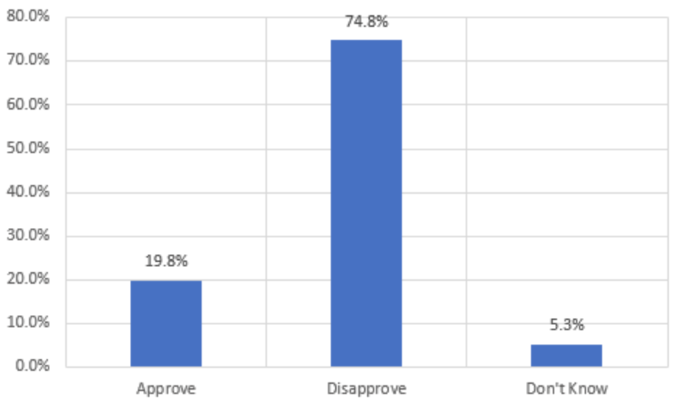
Question: Overall, do you approve or disapprove of the job Donald Trump is doing as president?
Notes:
Among the areas surveyed (mostly urban I believe), there is widespread disapproval for president Trump.

Slide 4
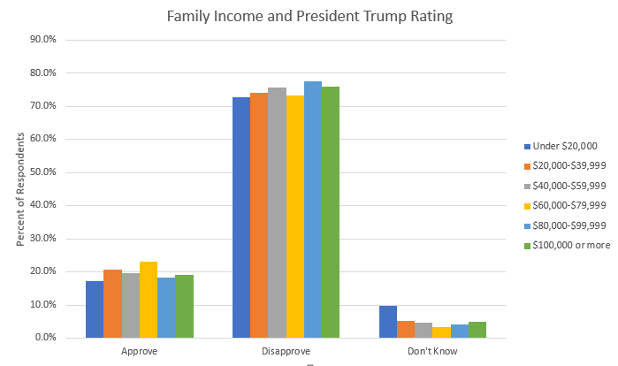
Income and Approval Rating
There is no statistically significant relationship between family income and approval or disapproval of the job President Trump is doing.

Slide 5
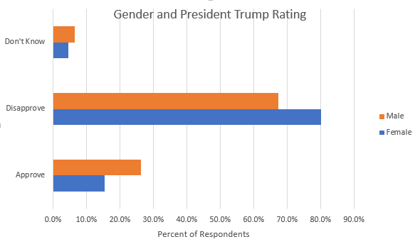
Gender and Approval Rating
Statistically Significant
 | Don’t Know | Disapprove | Approve
Male | 6.5% | 67.3% | 26.2%
Female | 4.5% | 80.1% | 15.4%
Difference | 2.0% | 12.8% | 10.8%

Slide 6
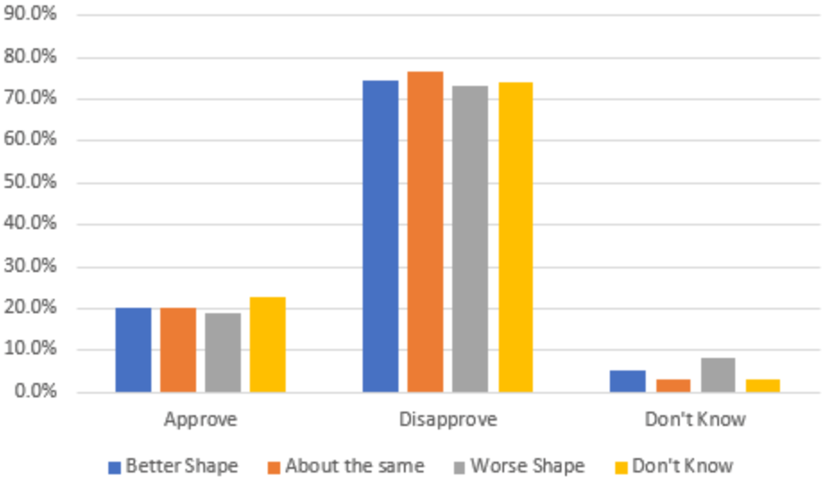
The Economy and Approval Rating
No Statistical Significance
Notes:
Economically speaking, people do not seem to have a huge concern with Trump’s job. This indicates that something about Trump’s performance that has to do with other things is what sparks his high disapproval among people surveyed.

Slide 7
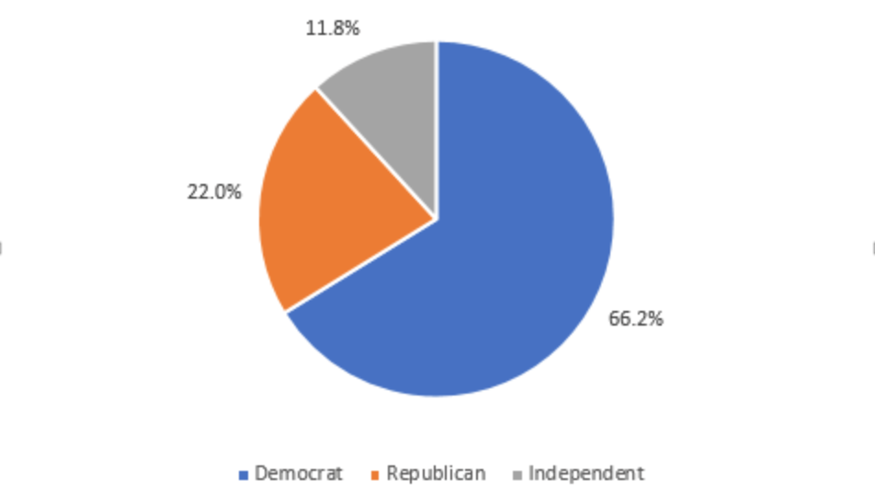
Ideology Breakdown

Slide 8
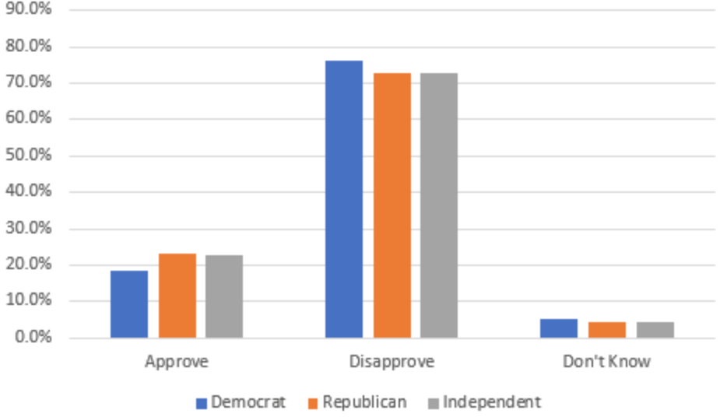
Party Identification and Approval Rating
Also No Statistical Significance
Notes:
The Party identification question, originally answered on a scale from 1-7 with 1 being strong democrat and 7 being strong republican, was re-coded so that people answering 1-3 were grouped as democrats, responses of 4 were grouped as independents, and responses of 5-7 were grouped as Republicans. Party Identification, at least in the areas surveyed, played no significant role in the approval or lack thereof for President Trump. However, the surveyed population was largely urban (I think), and since trump’s approval rating is somewhere in the 40%’s, there is likely to be something about urban republicans that Trump does not appeal to as opposed to rural republicans.

